Slide 1
Finding Data
Sean McMinn
Digital frameworks
Northwestern University – Summer 2018
Github.com/shmcminn/digitalframeworks-summer18

Slide 2
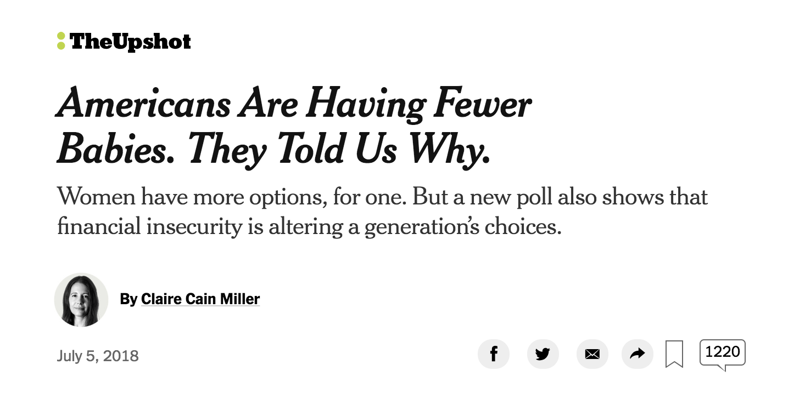
Data stories?
https://www.nytimes.com/2018/07/05/upshot/americans-are-having-fewer-babies-they-told-us-why.html?smid=tw-upshotnyt&smtyp=cur

Slide 3
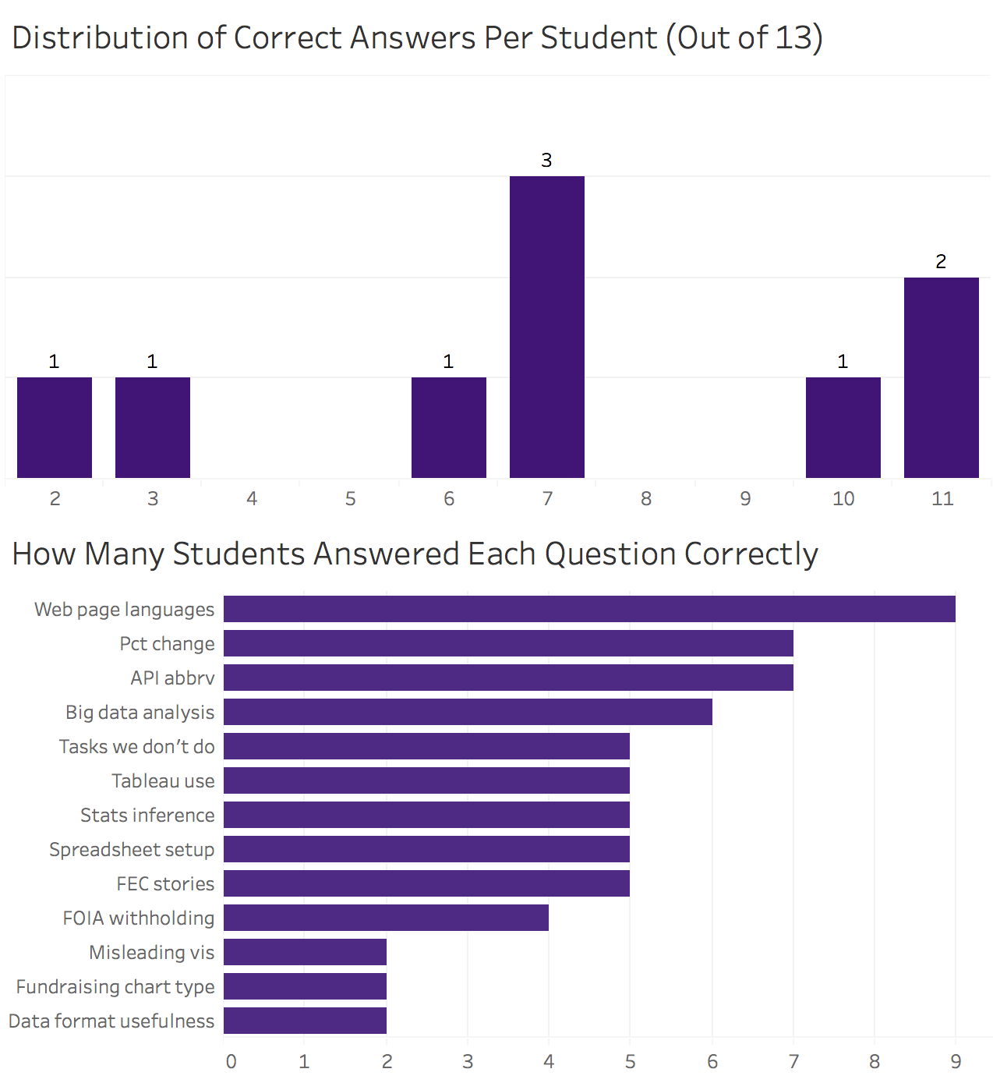

Slide 4
Steps to a data story
Find data
Clean data
Analyze data
Present data

Slide 5

Learning as we go

Slide 6
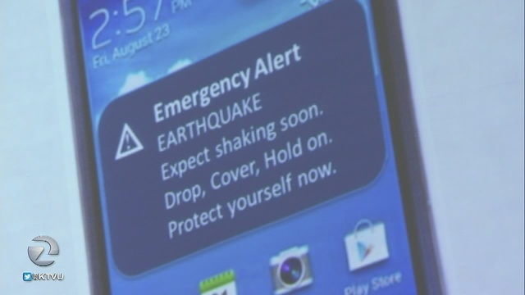
Learning as we go

Slide 7
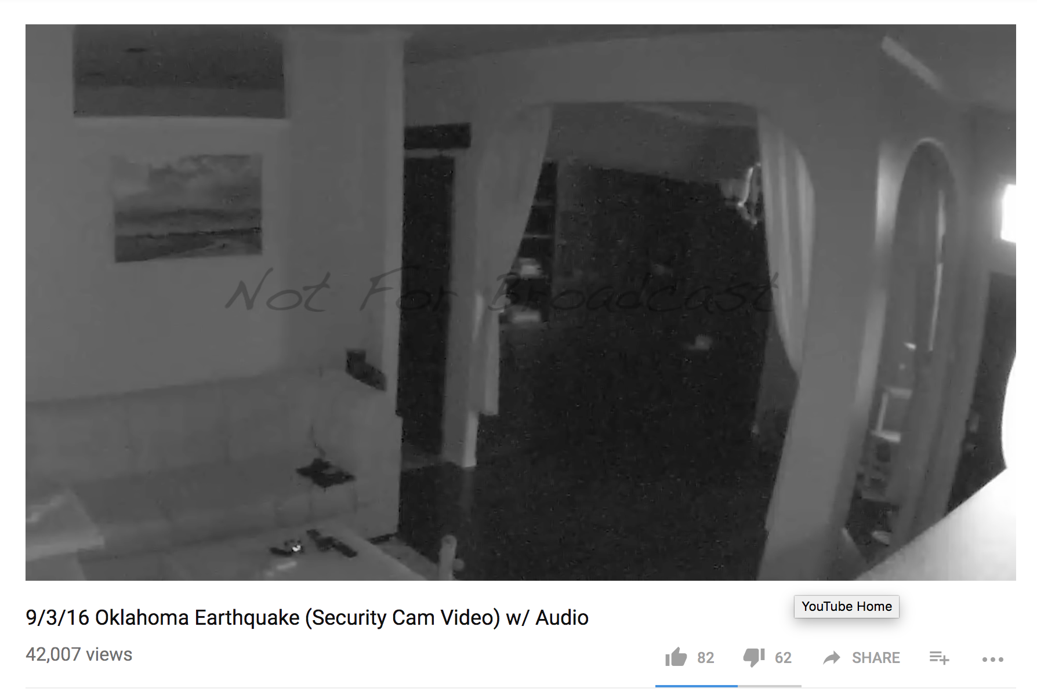

Learning as we go
What do reporters do when the shaking stops?

Slide 8
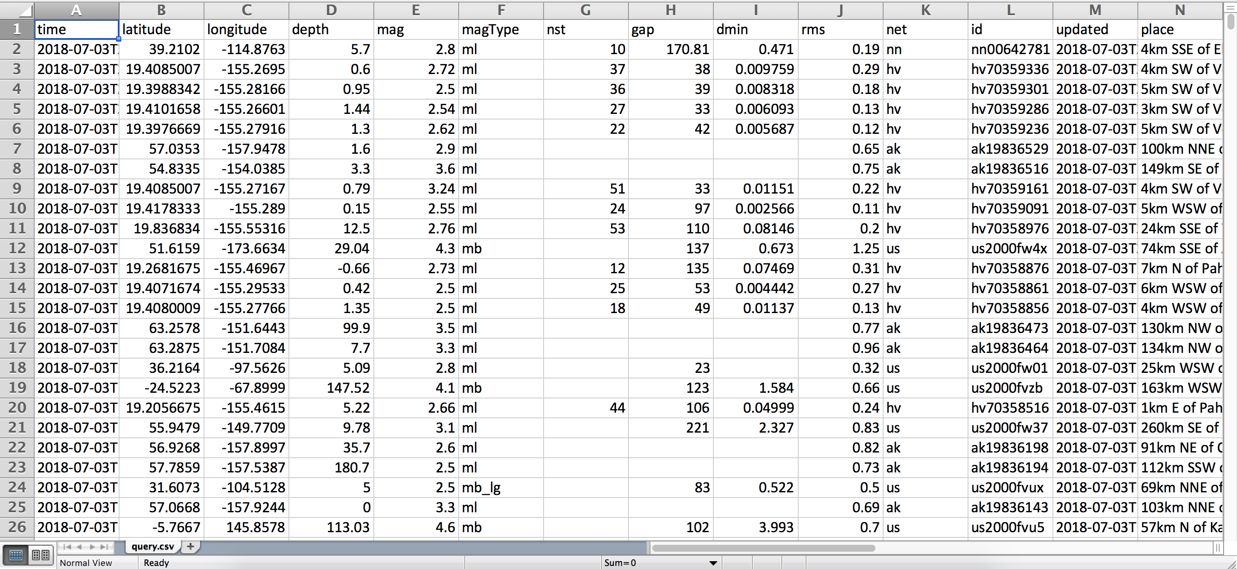
Learning as we go
What do reporters do when the shaking stops?

Slide 9
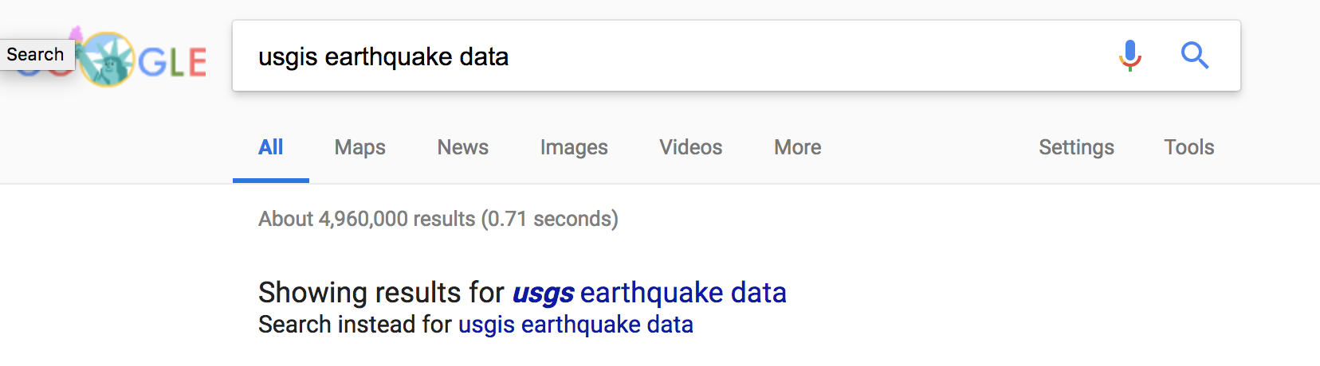
Learning as we go

Slide 10
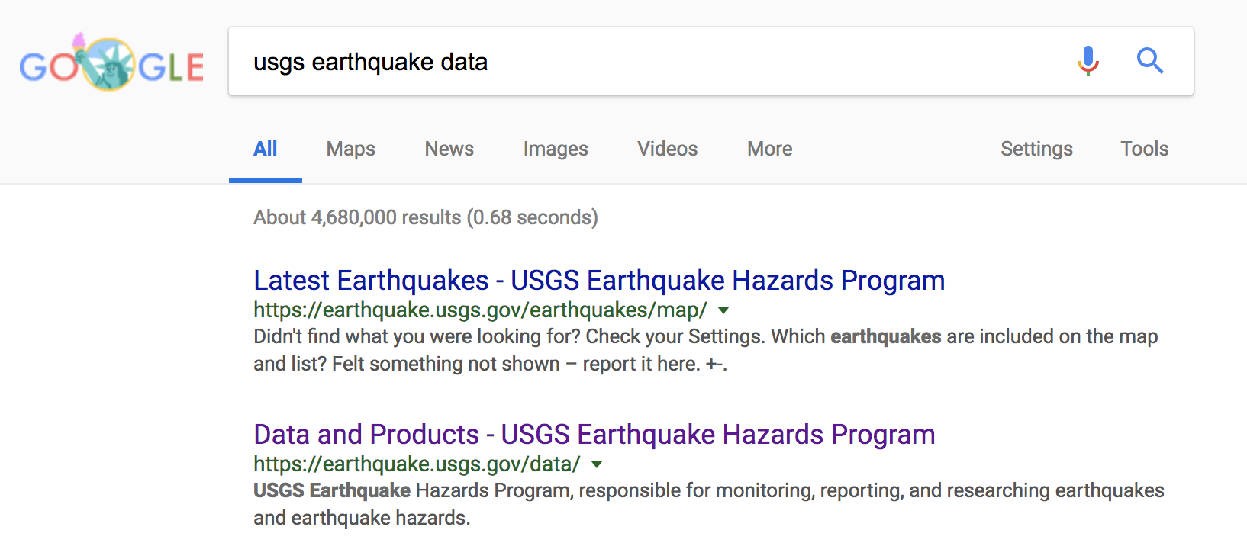
Learning as we go

Slide 11
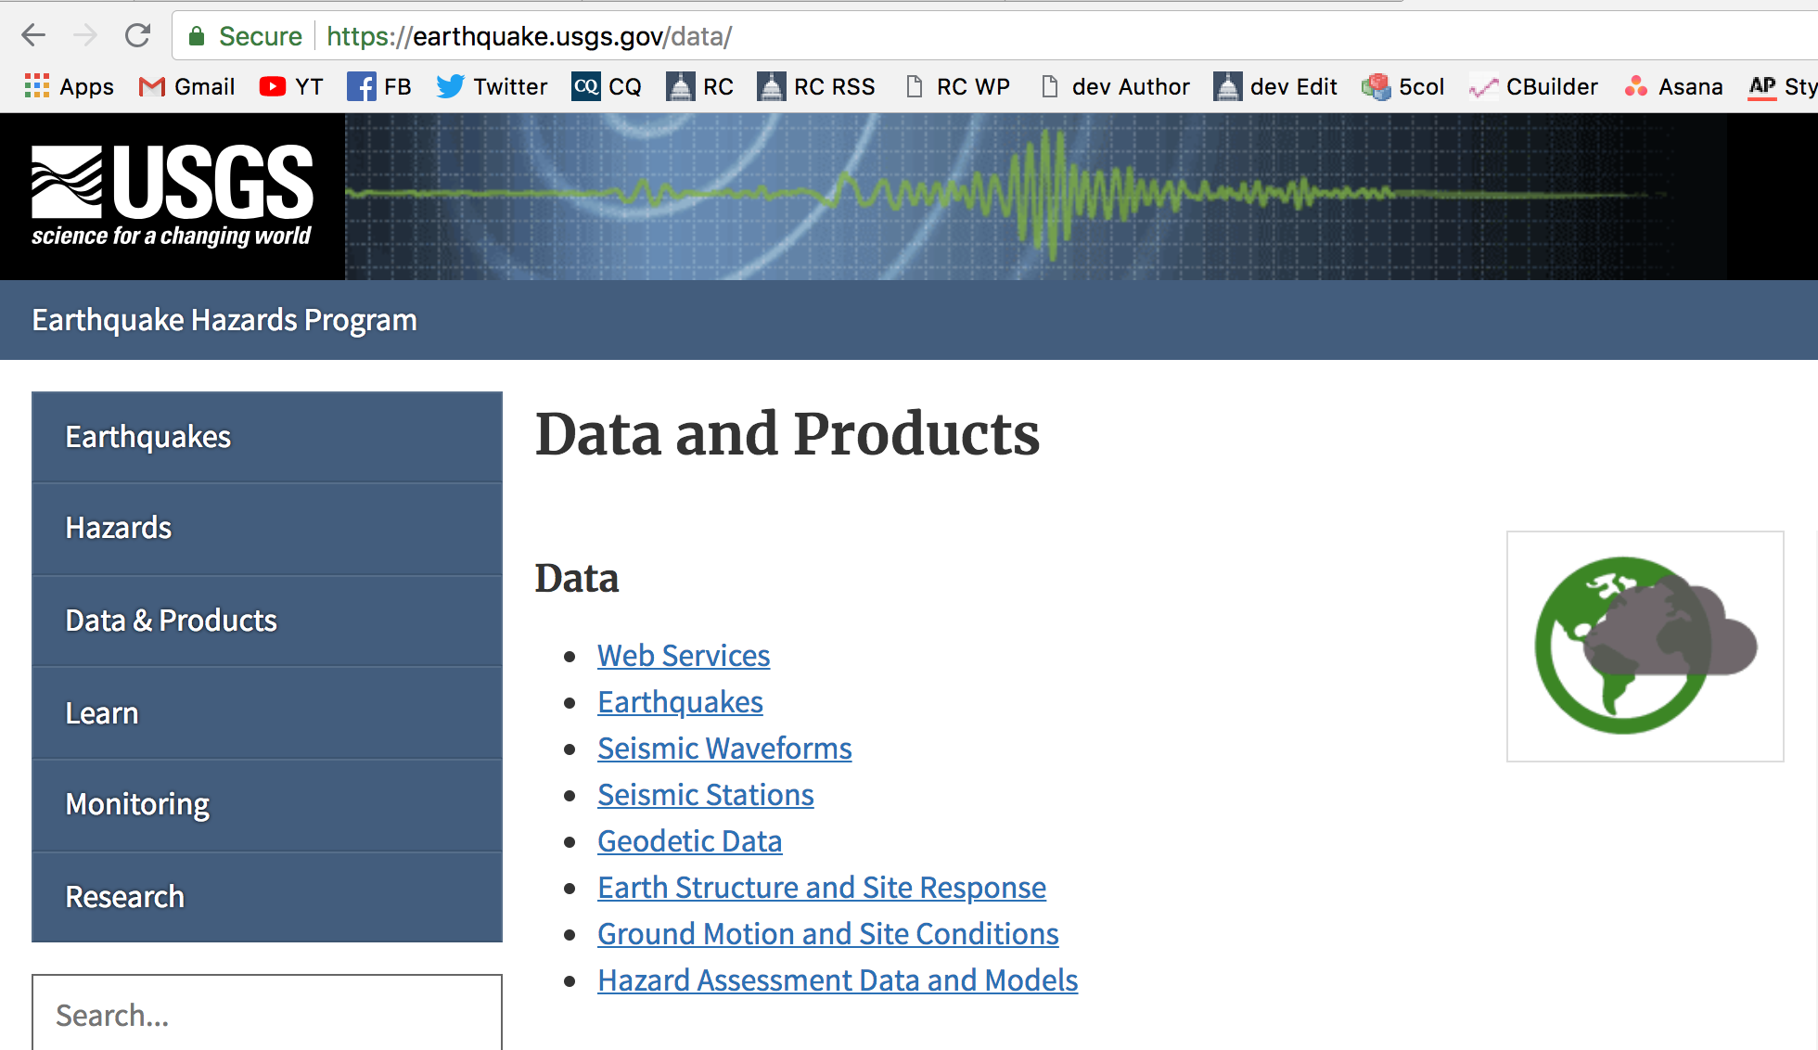
Learning as we go
What do reporters do when the shaking stops?

Slide 12
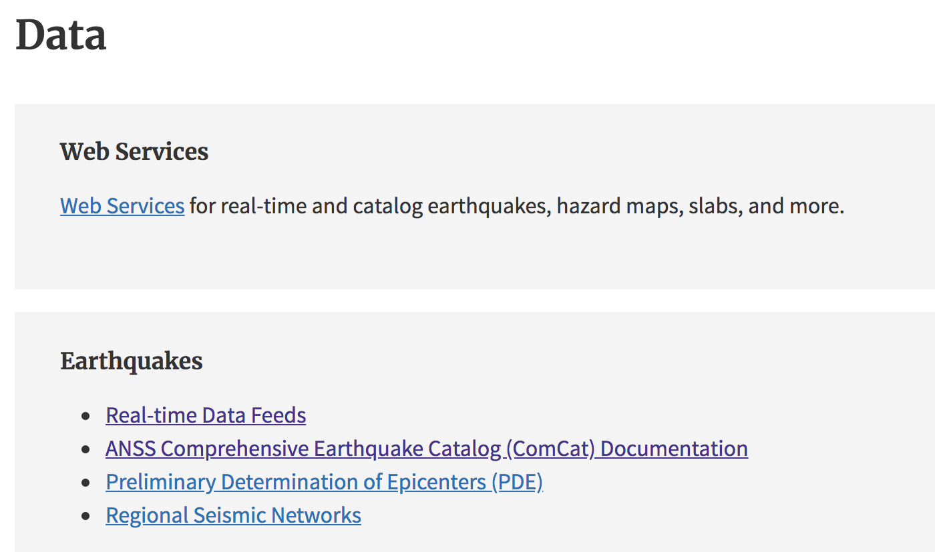
Learning as we go

Slide 13
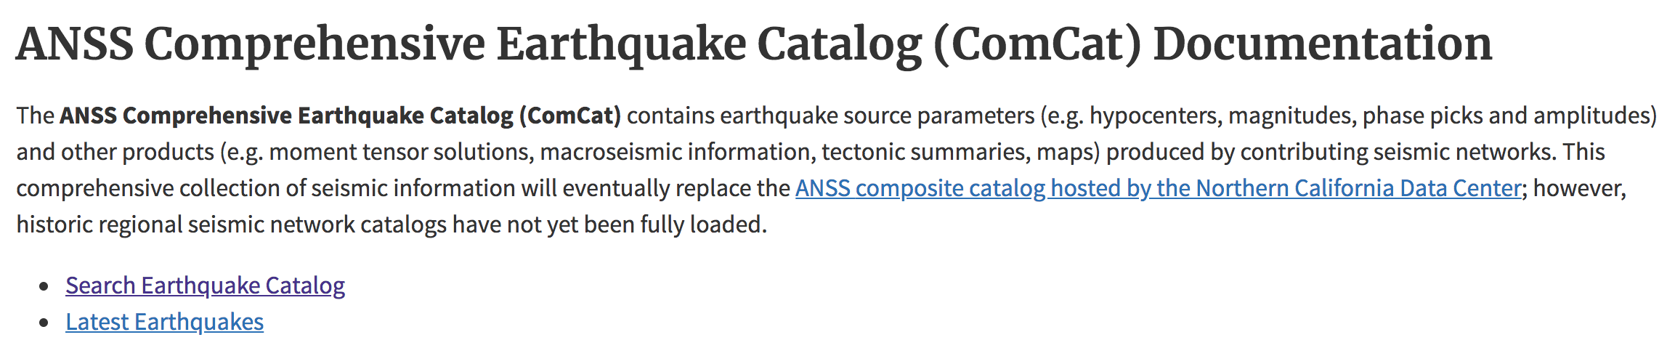
Learning as we go

Slide 14
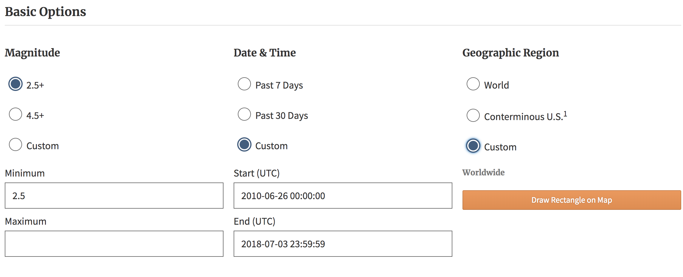
Learning as we go

Slide 15
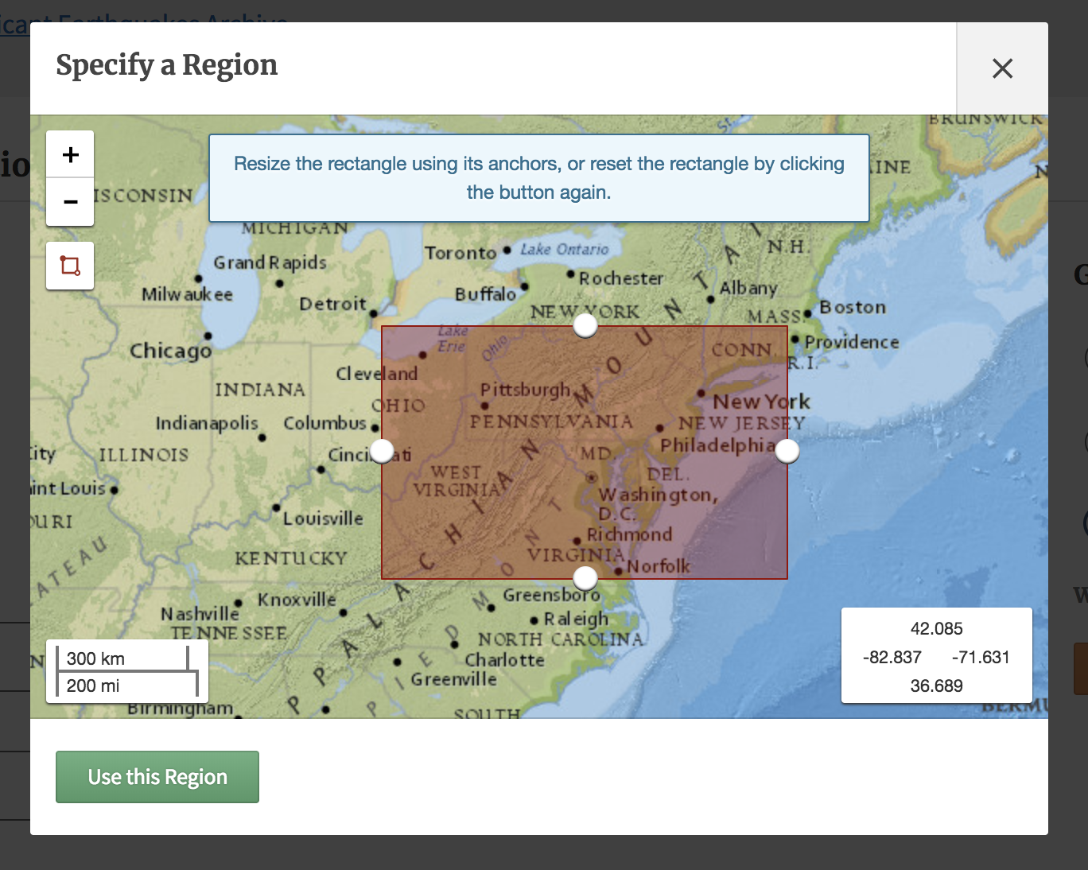
Learning as we go

Slide 16
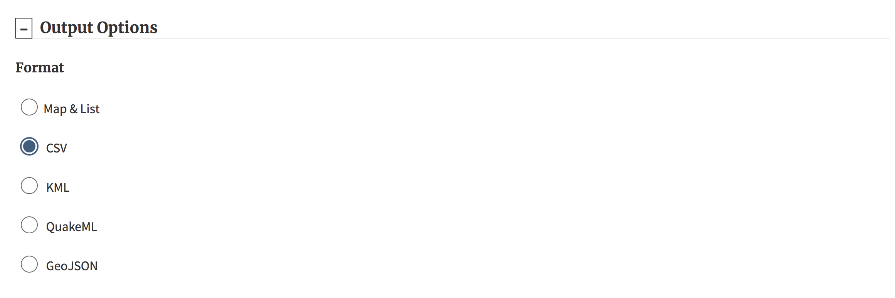
Learning as we go

Slide 17
Learning as we go

Slide 18

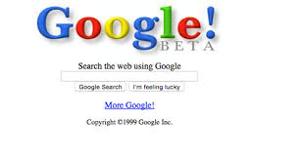
How do we know where to turn?
You have two VERY valuable assets

Slide 19

How do we know where to turn?
Notes:
Lots of good data… but be skeptical

Slide 20
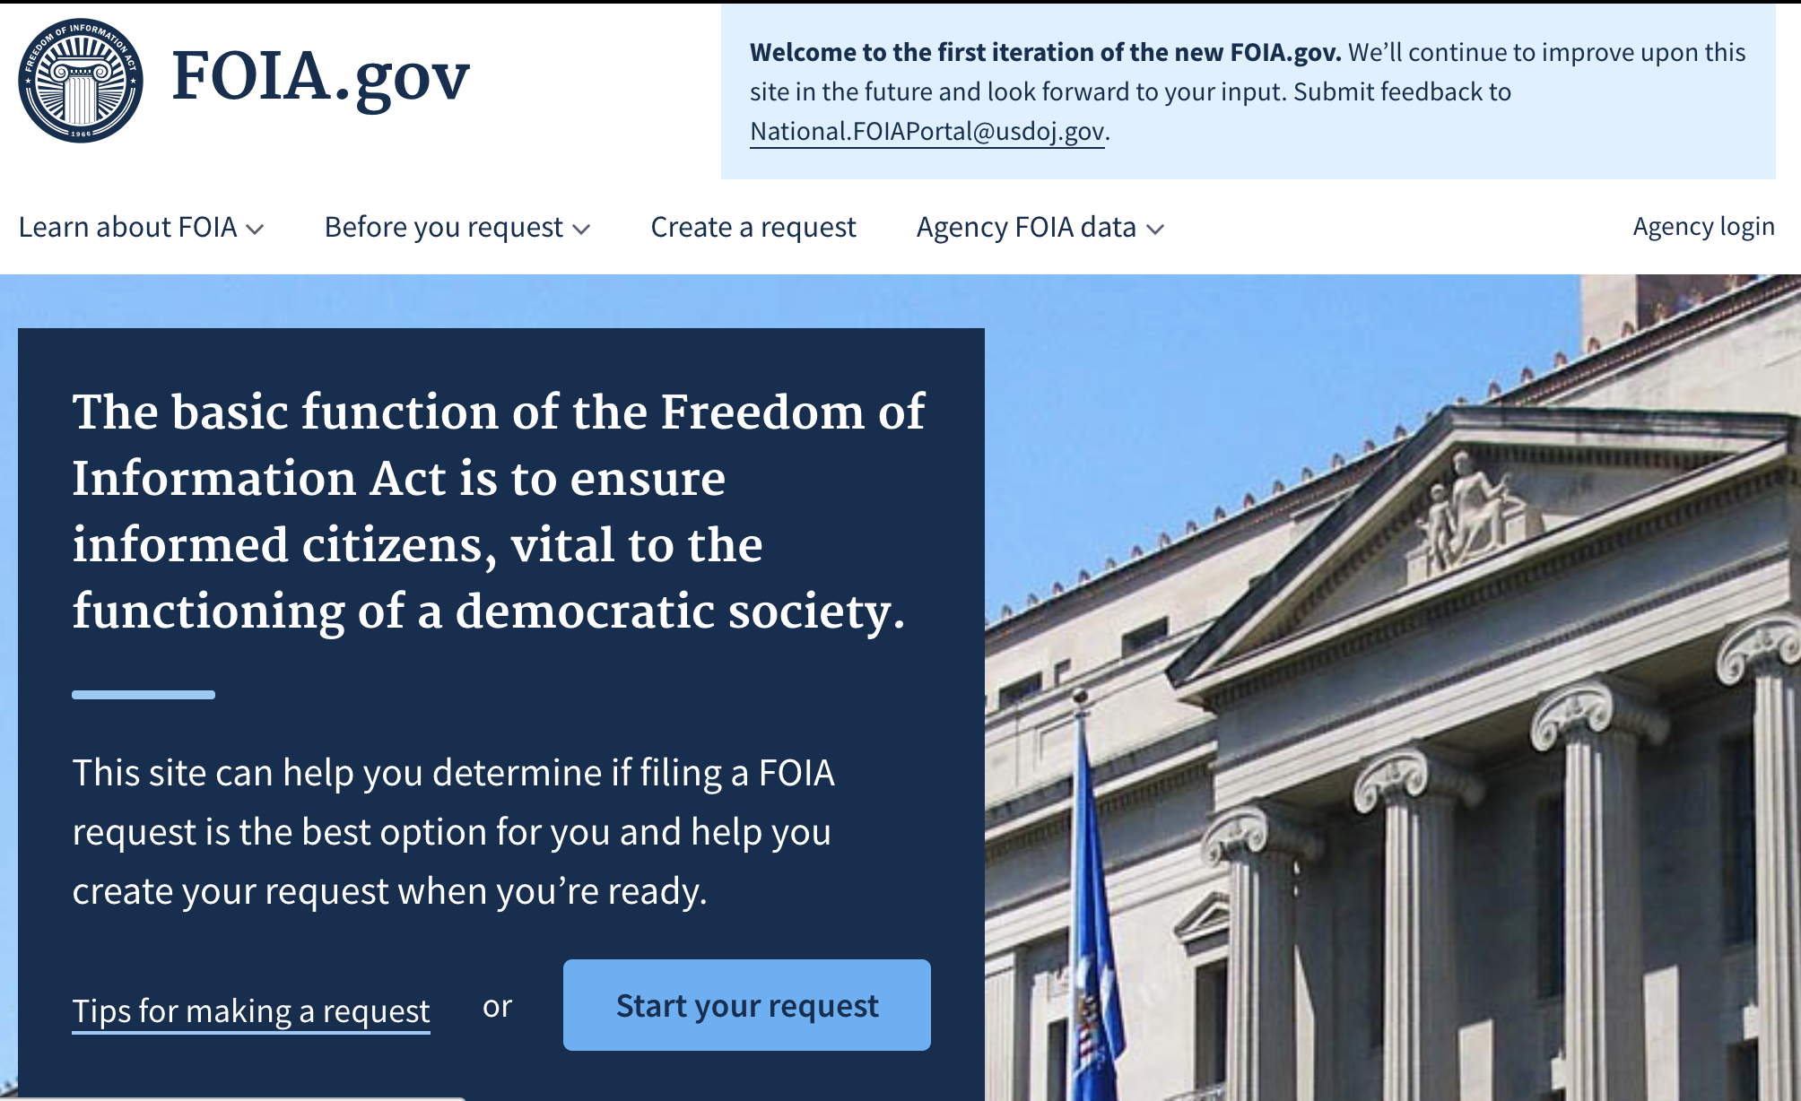
How do we know where to turn?
Notes:
Lots of good data… but be skeptical

Slide 21
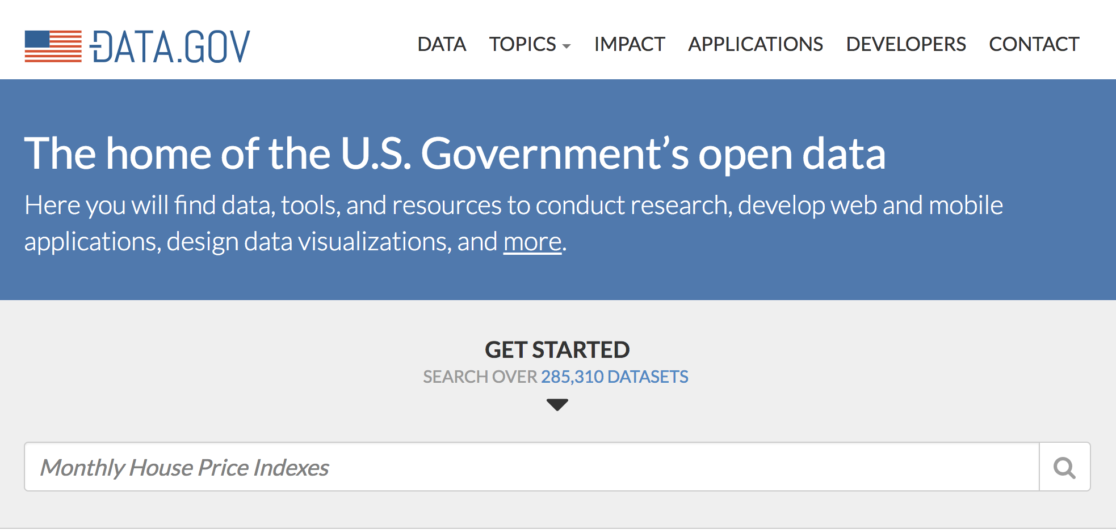
How do we know where to turn?
Notes:
Lots of good data… but be skeptical

Slide 22
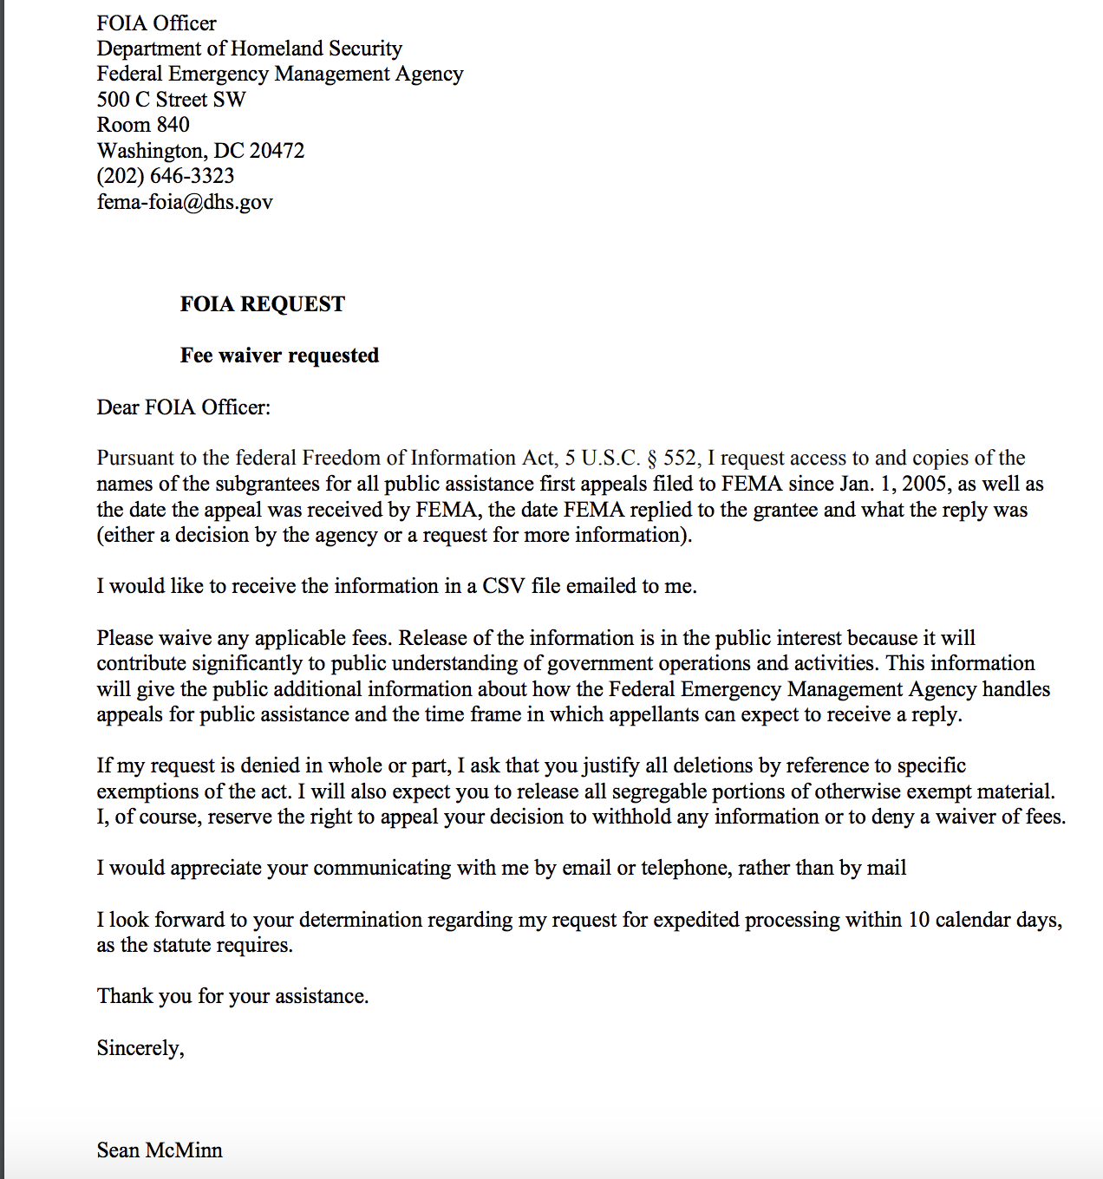
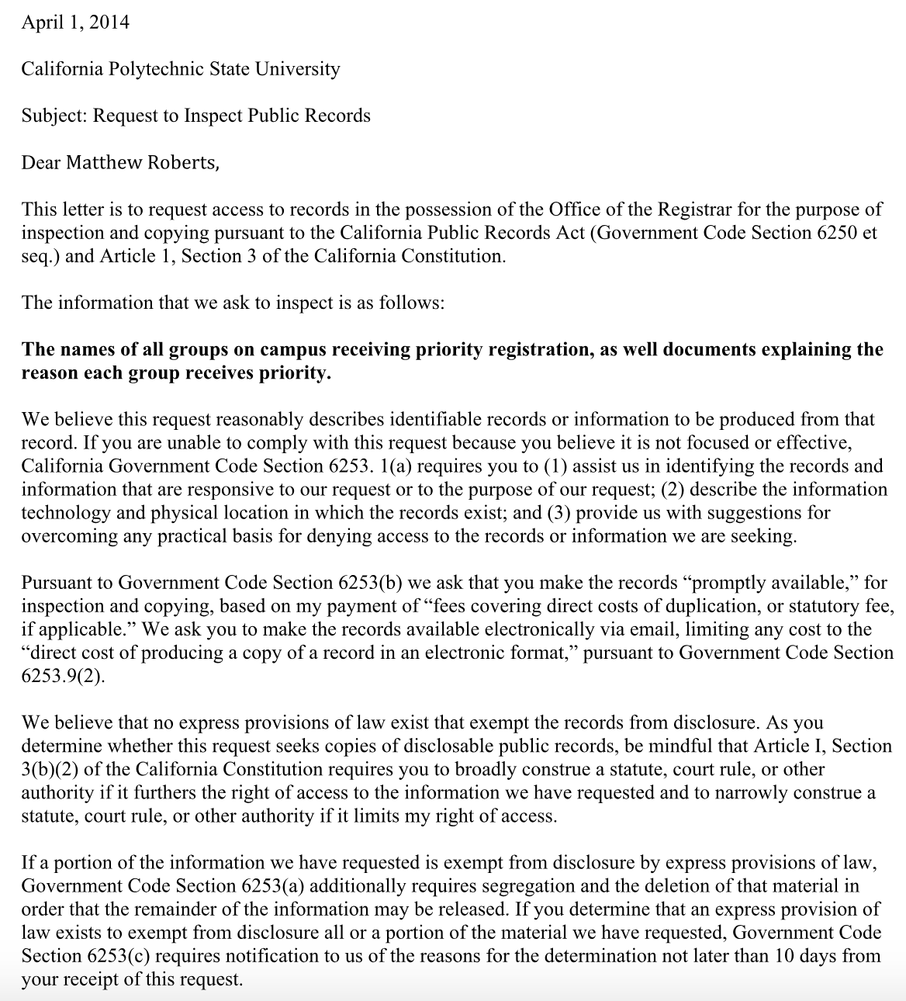
How do we know where to turn?
Notes:
Lots of good data… but be skeptical

Slide 23

Today’s guest
C.J. Ciaramella is a criminal justice reporter at Reason.
He was previously a politics editor at BuzzFeed, and a reporter for the Washington Free Beacon. His writing has also appeared in Vanity Fair, Vice, The Weekly Standard, High Times, Salon, The Federalist, Pacific Standard, The Washington Post, The Daily Beast, the San Diego Union-Tribune, and Street Sense.
Twitter: @cjciaramella

Slide 24
Other places to find data
Non-profits
Think tanks
Academics

Slide 25
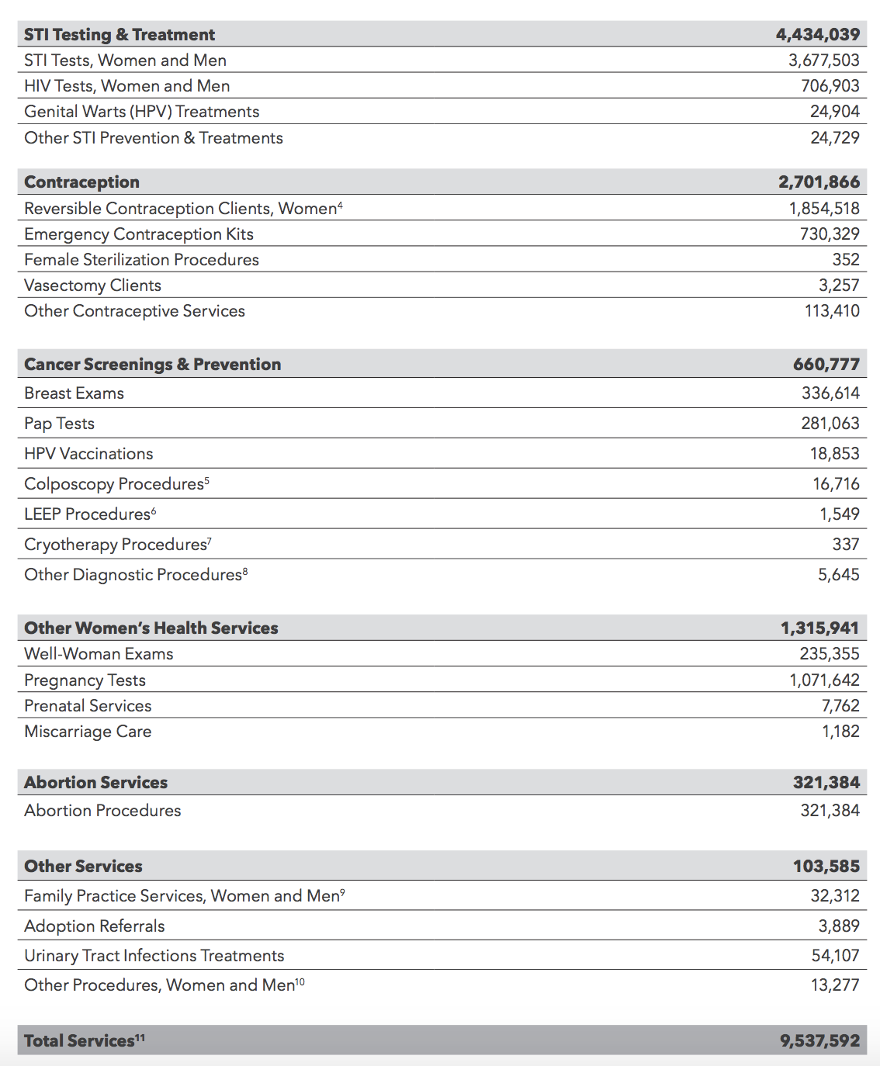

Other places to find data
Reports

Slide 26
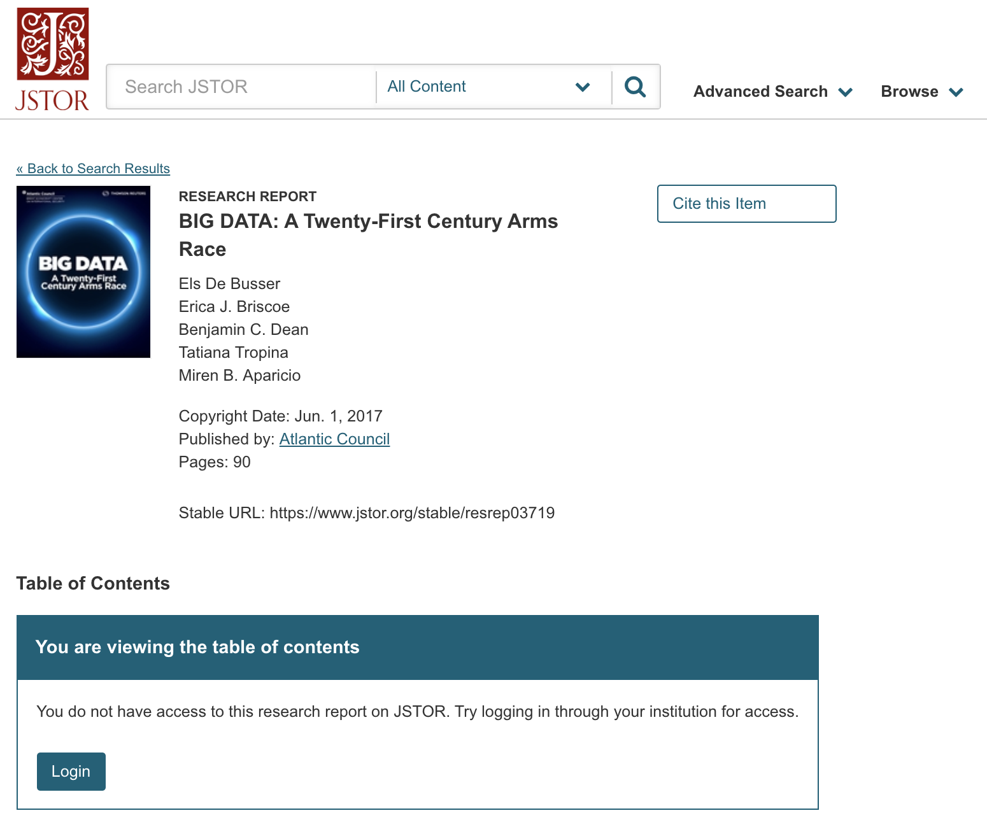
Other places to find data
Journal reports: ask the author(s) for a copy!

Slide 27
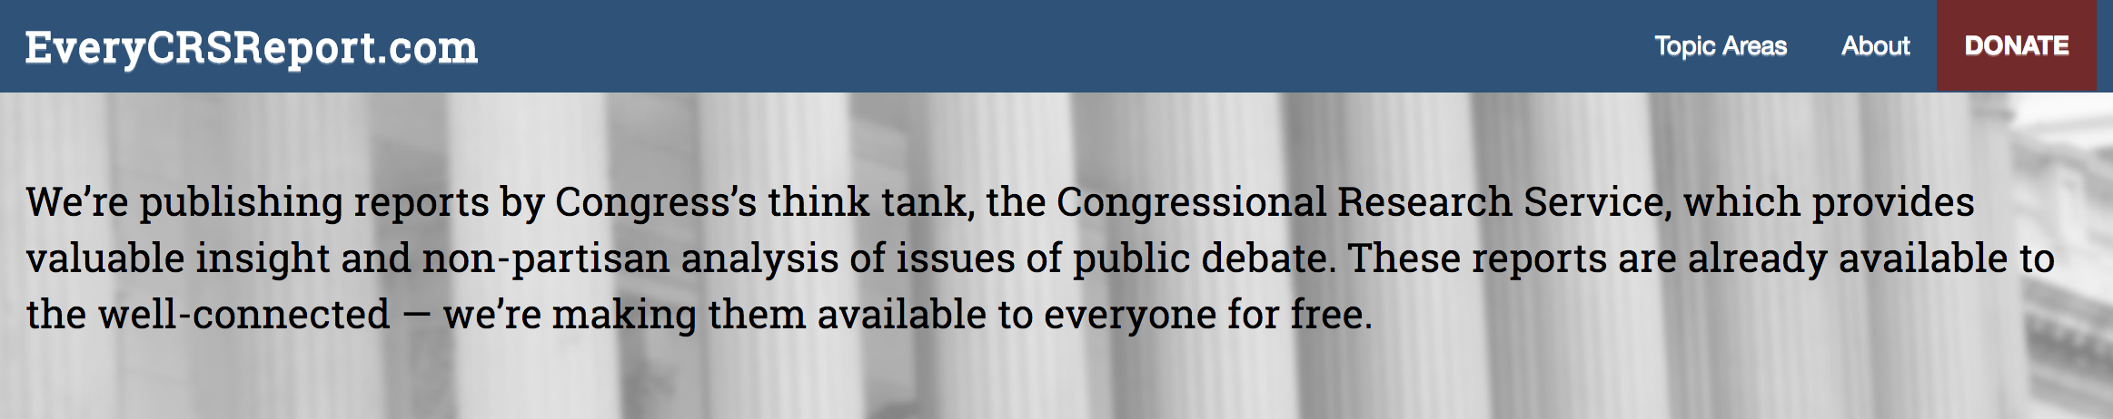

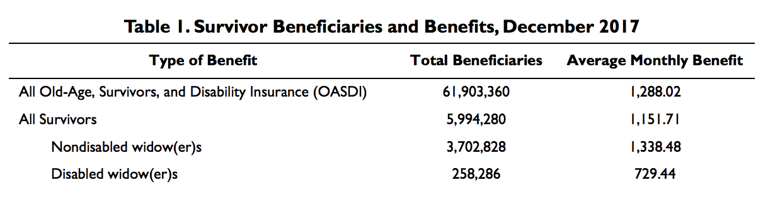
Other places to find data
CRS = Think tank for Congress

Slide 28
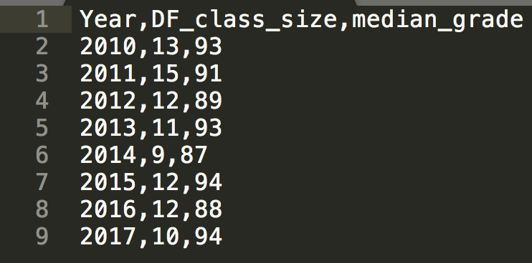
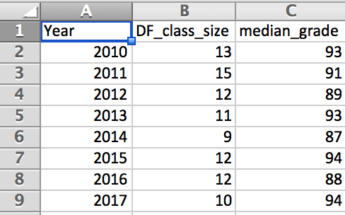
Data types
CSV: comma separated values
Most useful for reporters
Problems when data have commas in cells

Slide 29
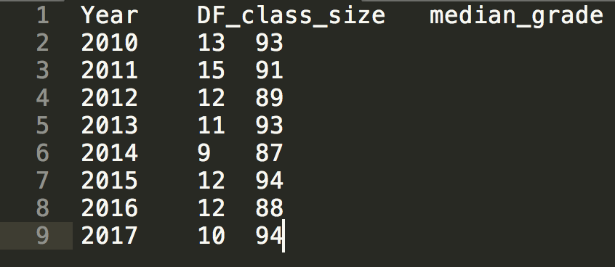
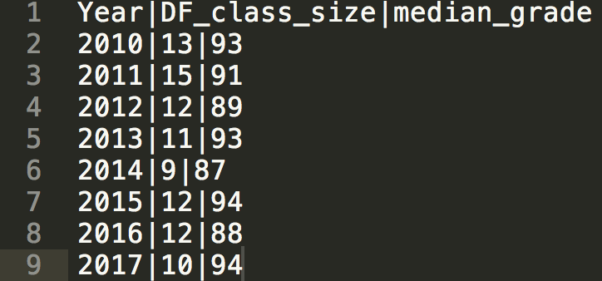
Data types
Can technically separate by anything
Common separators: tabs (TSV), pipes

Slide 30
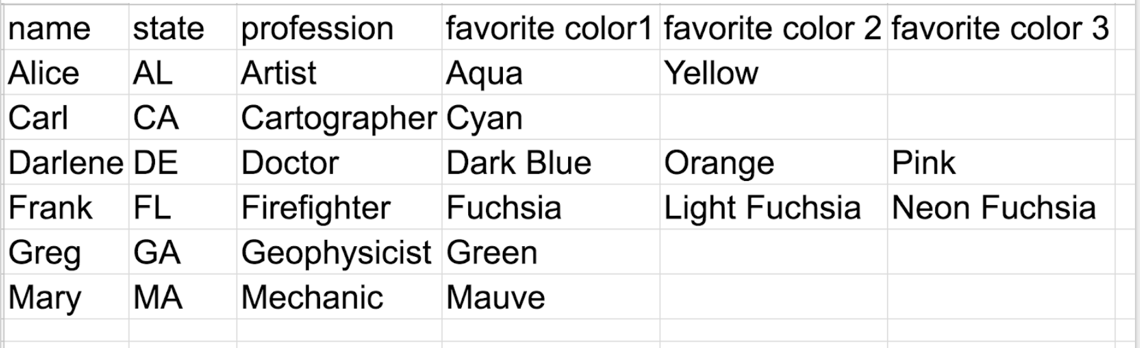
Data types
CSVs: multiple category problem

Slide 31
Data types
XML: eXtensible markup language
Human and machine readable

Slide 32
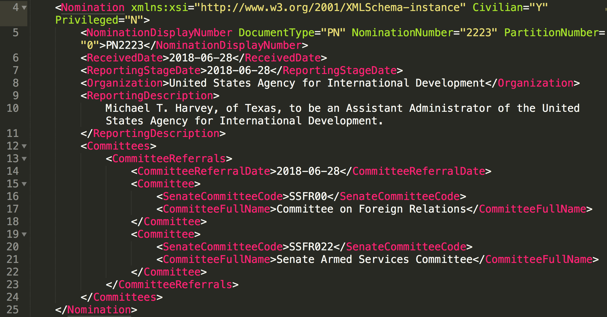
Data types

Slide 33
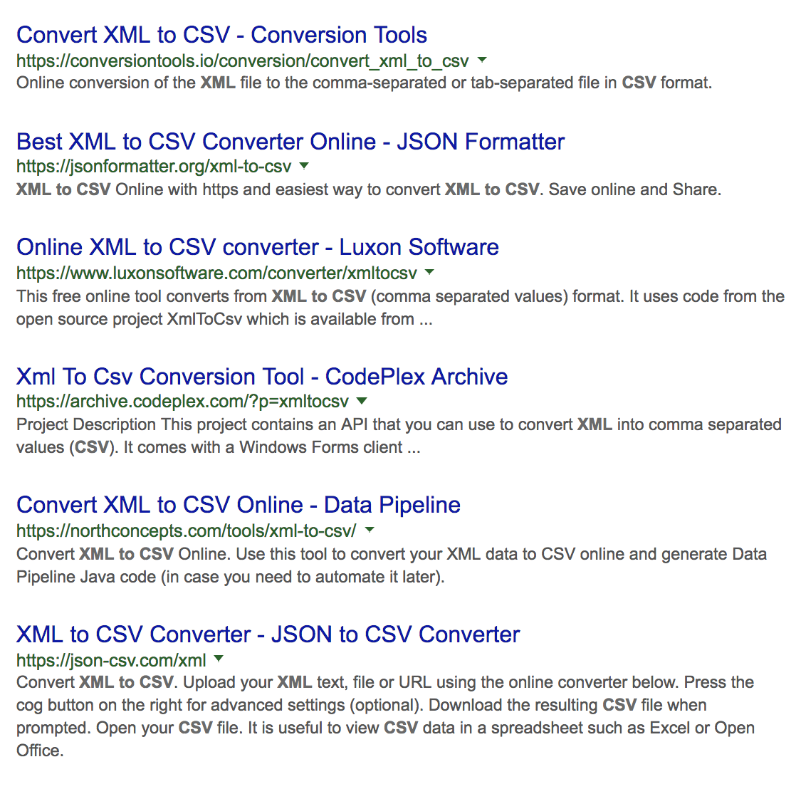
Data types
For XML, sometimes it’s best to just convert to CSV

Slide 34
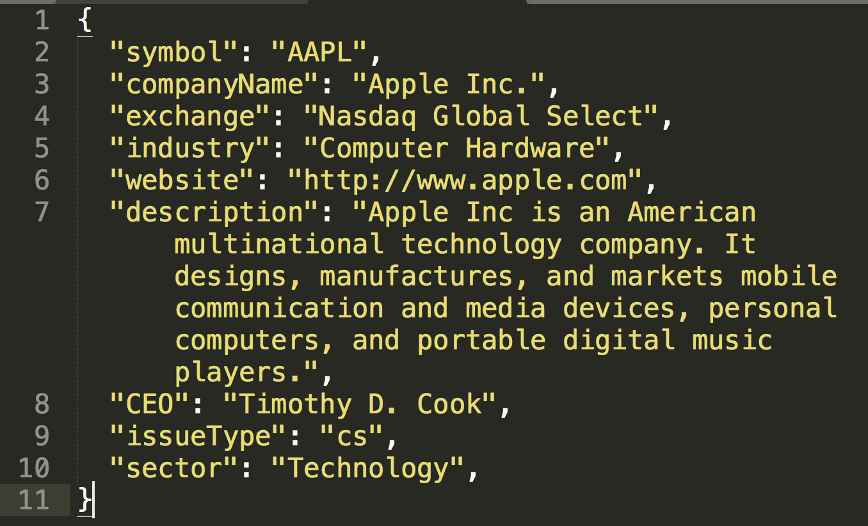
Data types
JSON: JavaScript Object Notation
Not just Javascript

Slide 35
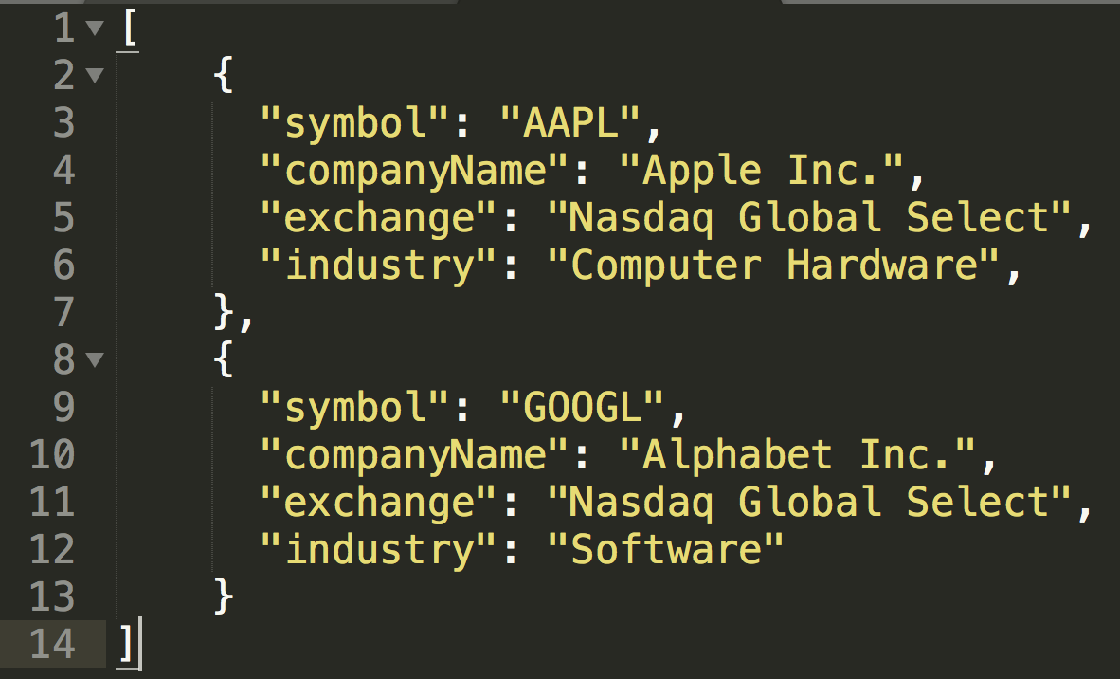
Data types
Multiple JSON objects can be put together in an array (like rows in a spreadsheet)

Slide 36
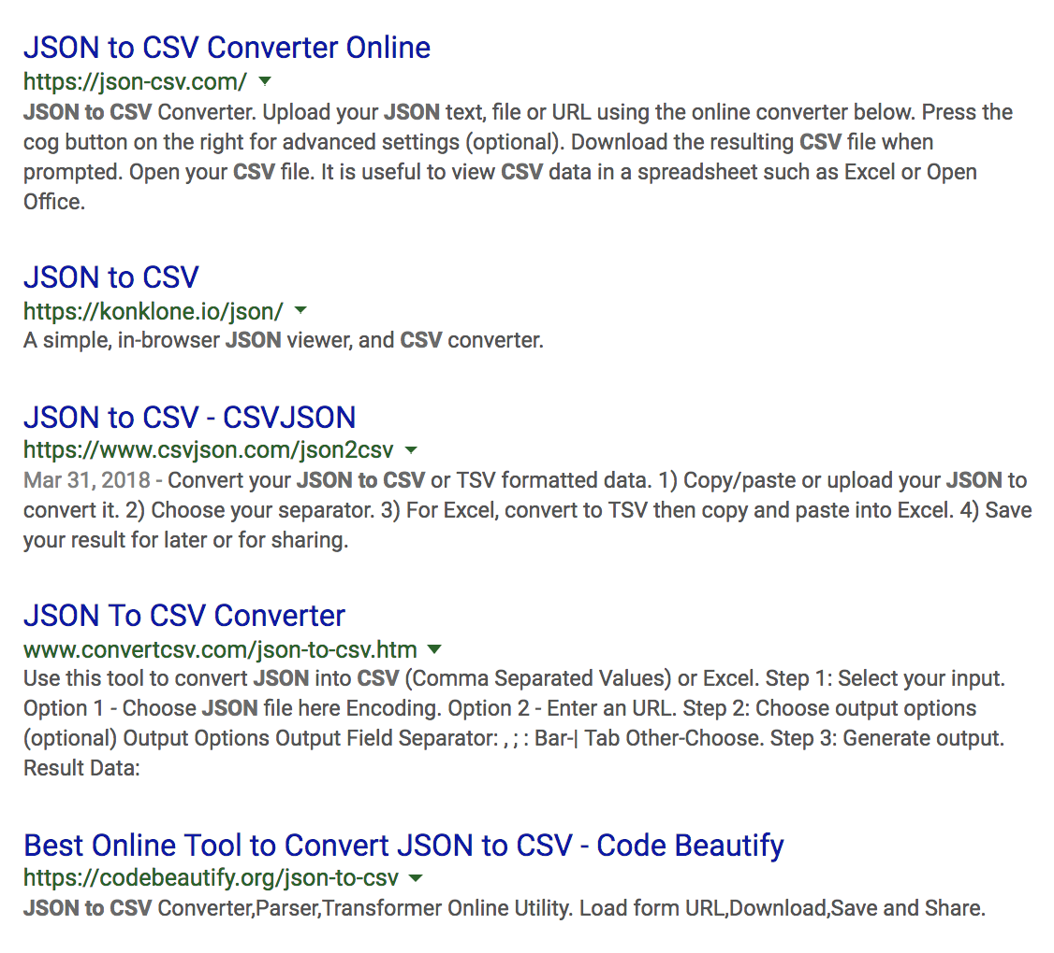
Data types
And just like XML, you can convert these into CSVs, too

Slide 37
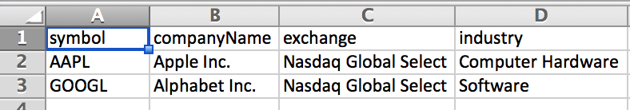
Data types
So this =>
Becomes this =>

Slide 38
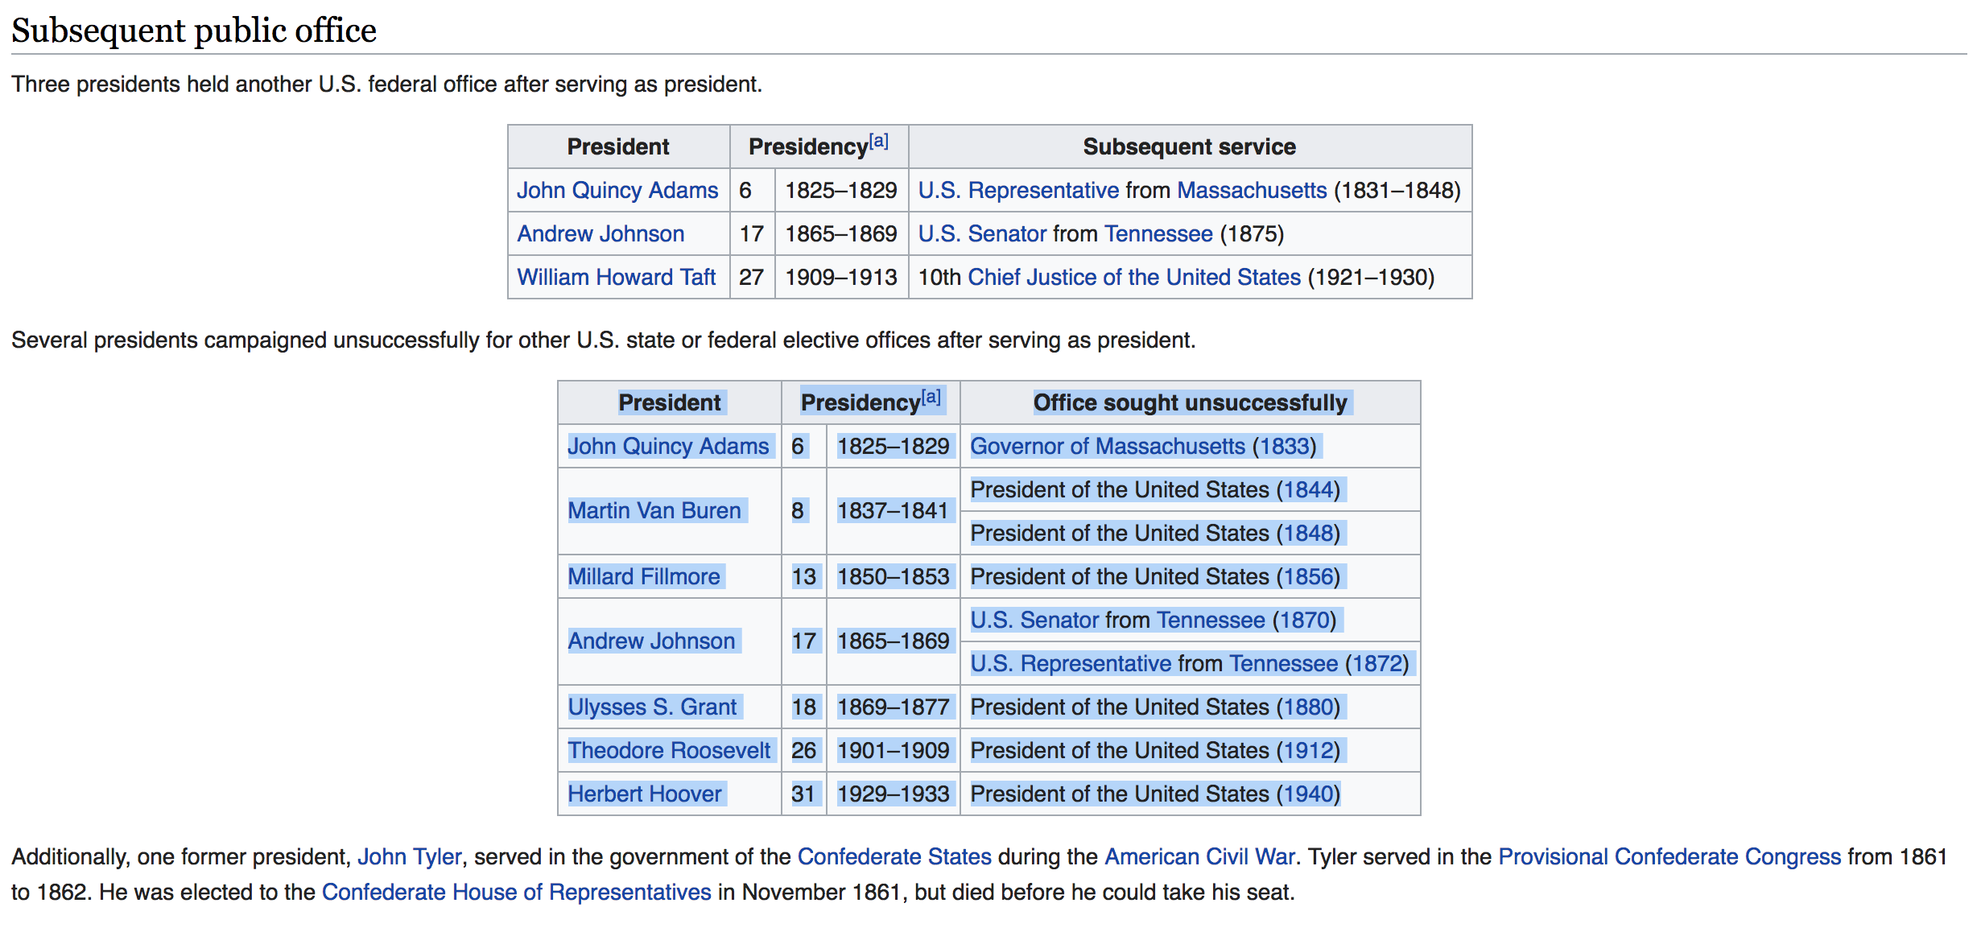
Data types
HTML
If a download isn’t available, you can check to see if the data is on the web page itself

Slide 39
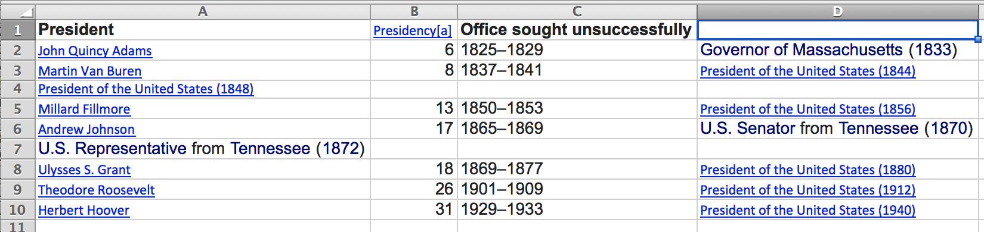
Data types
HTML
If a download isn’t available, you can check to see if the data is on the web page itself

Slide 40
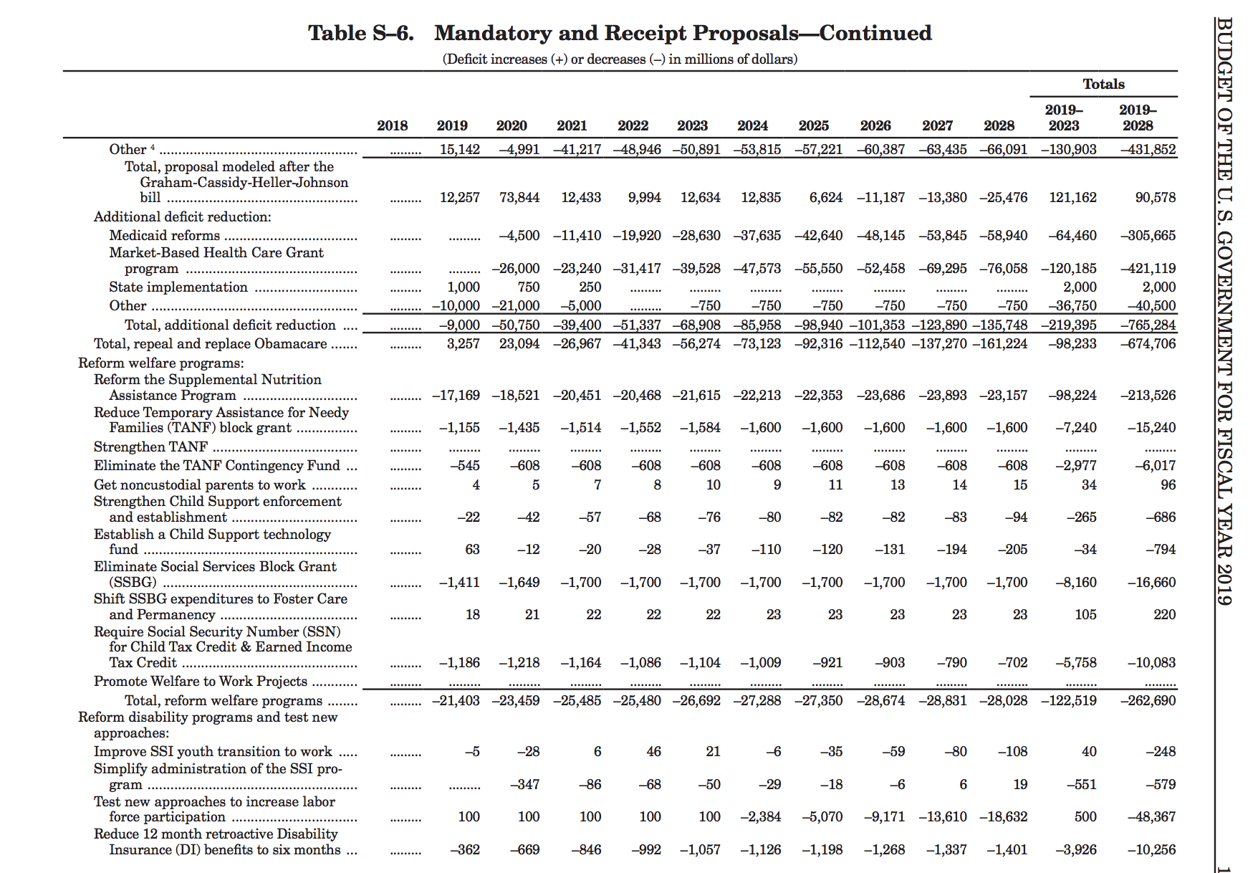


Data types
PDF

Slide 41
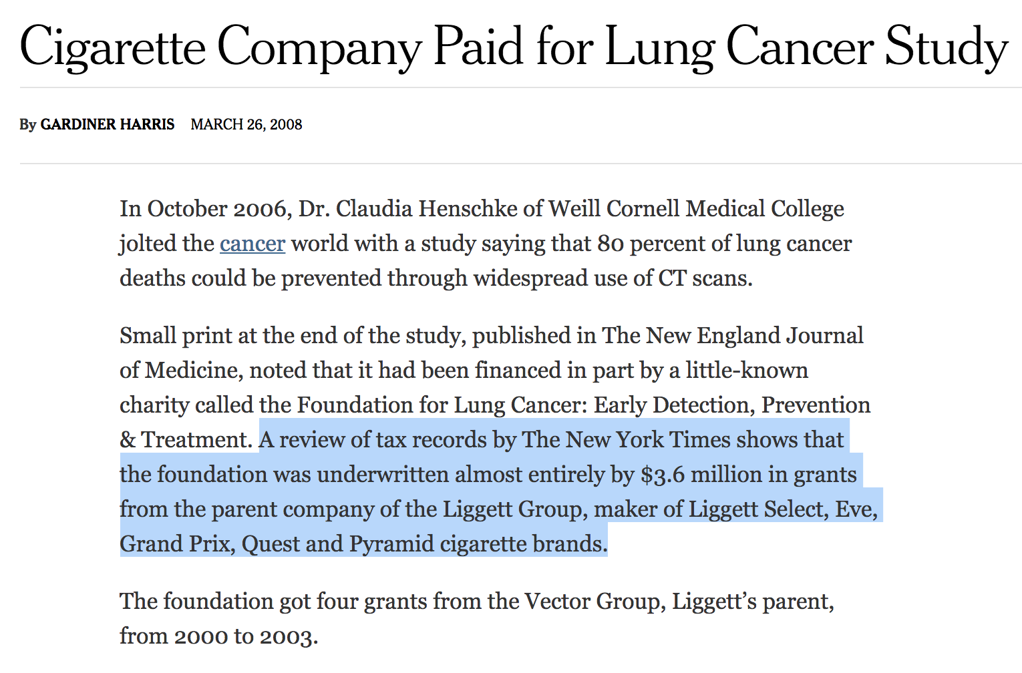
Thinking critically
Notes:
Who’s behind it?

Slide 42
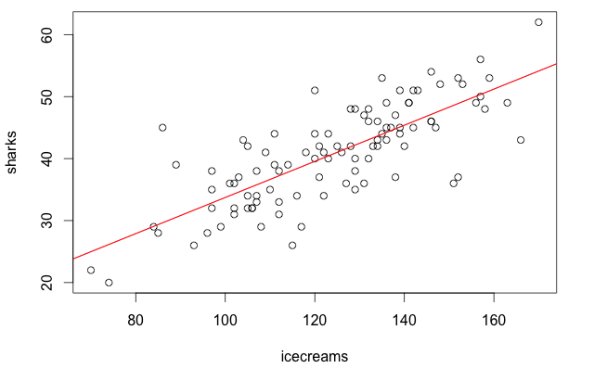
Thinking critically
Notes:
What’s missing?

Slide 43
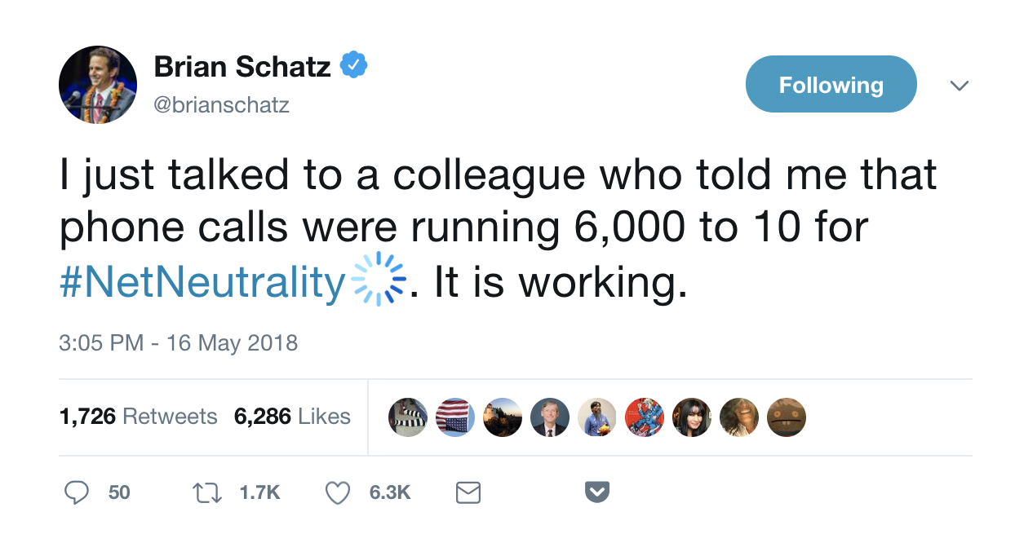
Thinking critically
Notes:
Can you view the underlying data?

Slide 44
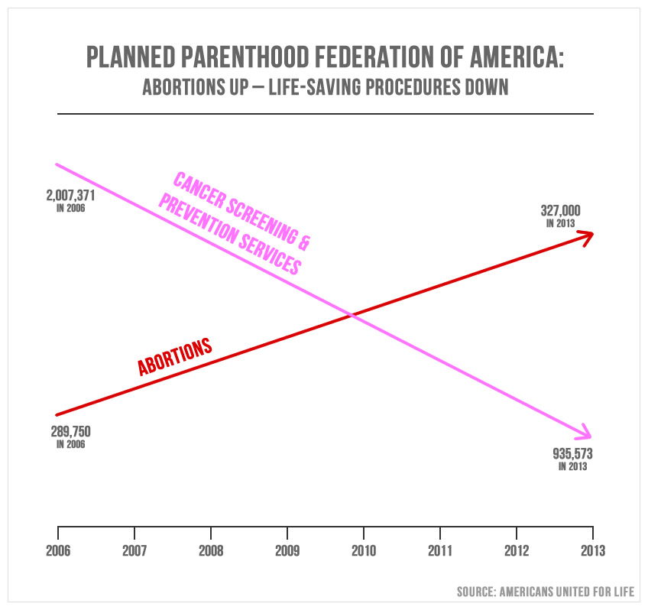
Thinking critically

Slide 45
Thinking critically
Who’s behind it?
Americans United for Life is an American pro-life public interest law firm and advocacy group based in Washington, D.C.: Wikipedia
Utah Republican Jason Chaffetz presented in committee hearing
What’s missing?
Accurate scale
Data between 2006 and ‘13
Underlying data set
Yes!

Slide 46
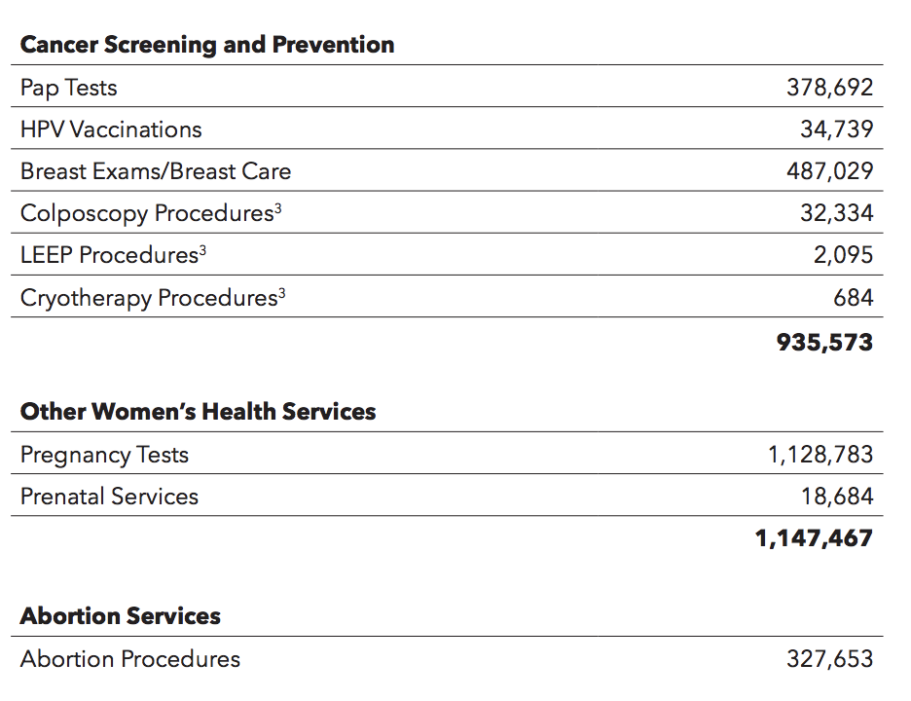
Thinking critically

Slide 47
Thinking critically
Get the data about the data
Who created it?
Who is responsible for maintaining it?
What point in time or time-range does it apply to?
How was the data collected?
How was the data processed after being collected?
How was each field collected or calculated?
(from David Eads of ProPublica, IL)
http://training.npr.org/visual/what-to-do-with-a-big-pile-of-data/

Slide 48
Thinking critically
Which of these would you expect to be the most/least trustworthy dataset?
A. Think tank report from the right-leaning Cato Institute on nuclear arms policy
B. Report from minority staff of House Intelligence Committee on actors in Russia investigation
C. Washington DC Parks and Recreation Department data on vandalism cleanups in public parks
D. FOIA’d data from Turlock, Calif., (pop. 72,800) on incidents of bubblegum stuck to bottom of desks

Slide 49
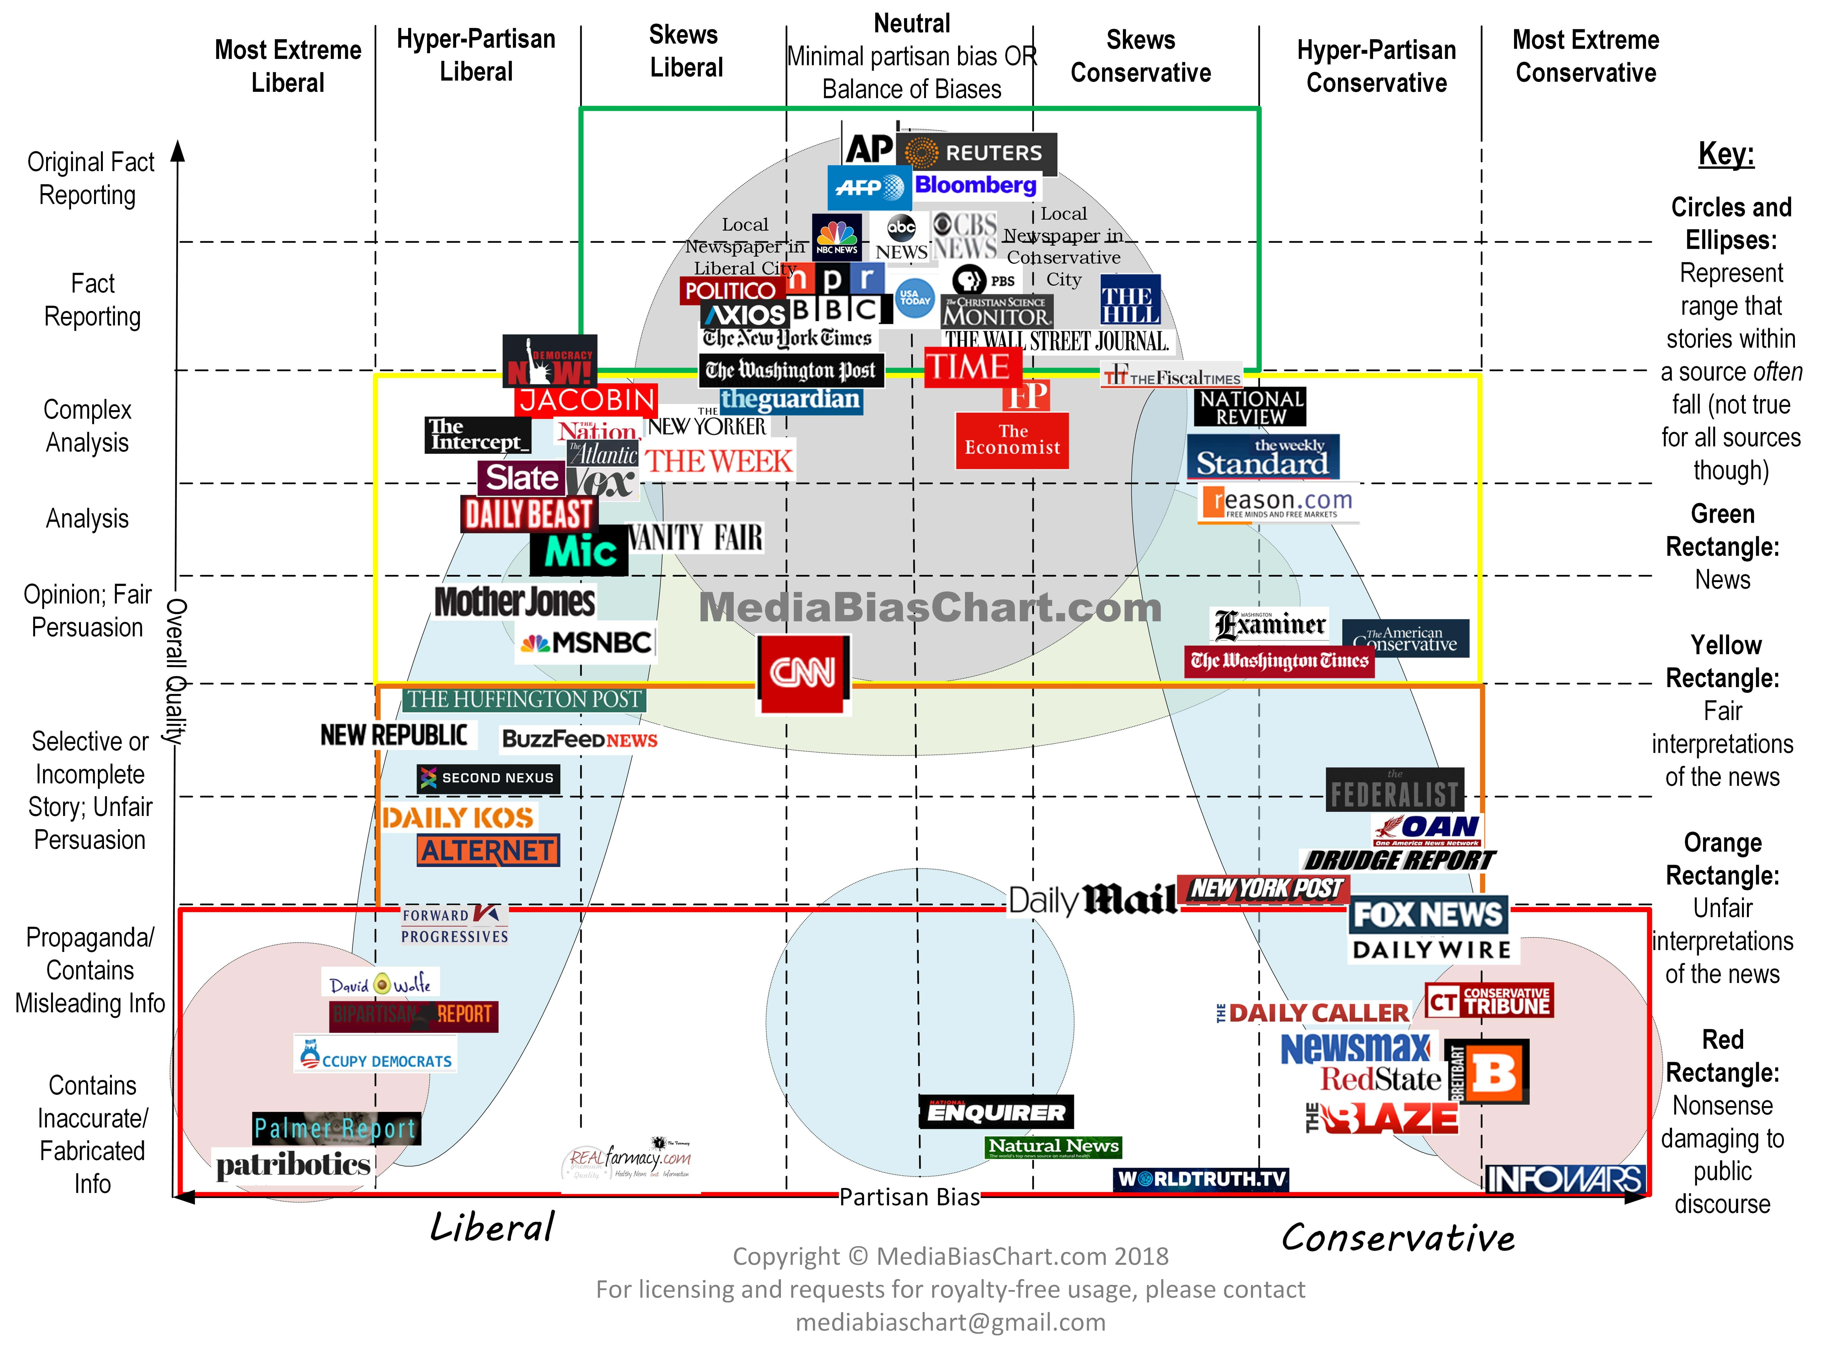
Thinking critically

Slide 50
Thinking critically
In pairs:
Find a dubious dataset or data-driven claim
Evaluate why it may not be credible AND who may stand to gain from it
See if credible publicly available data can confirm or contradict it
Present findings to class

Slide 51
Making your own database
What are you collecting?
Trickier than it sounds: be specific!
Start question: How much time are World Cup teams wasting?
https://fivethirtyeight.com/features/which-world-cup-team-is-the-best-at-wasting-time/
More detail: How long it takes 2018 World Cup teams to do throw-ins, goal kicks, corner kicks, free kicks and substitutions

Slide 52
Making your own database
Think about data you might need down the road — not always obvious
For soccer:
Time/date
Round of tournament
Weather outside
These could all affect how much time players take, and you don’t want to have to go back and get them after you’ve already collected your data

Slide 53
Making your own database
Questions that may pop up:
Does it count if there’s an injury during a throw-in?
Do we factor in time the referee is holding the game before a free kick?
Answer these kinds of questions as soon as possible

Slide 54
Making your own database
Where can you get your “data”?
Original documents
Surveys
Sensors
Photos/videos
News reports
Observations

Slide 55
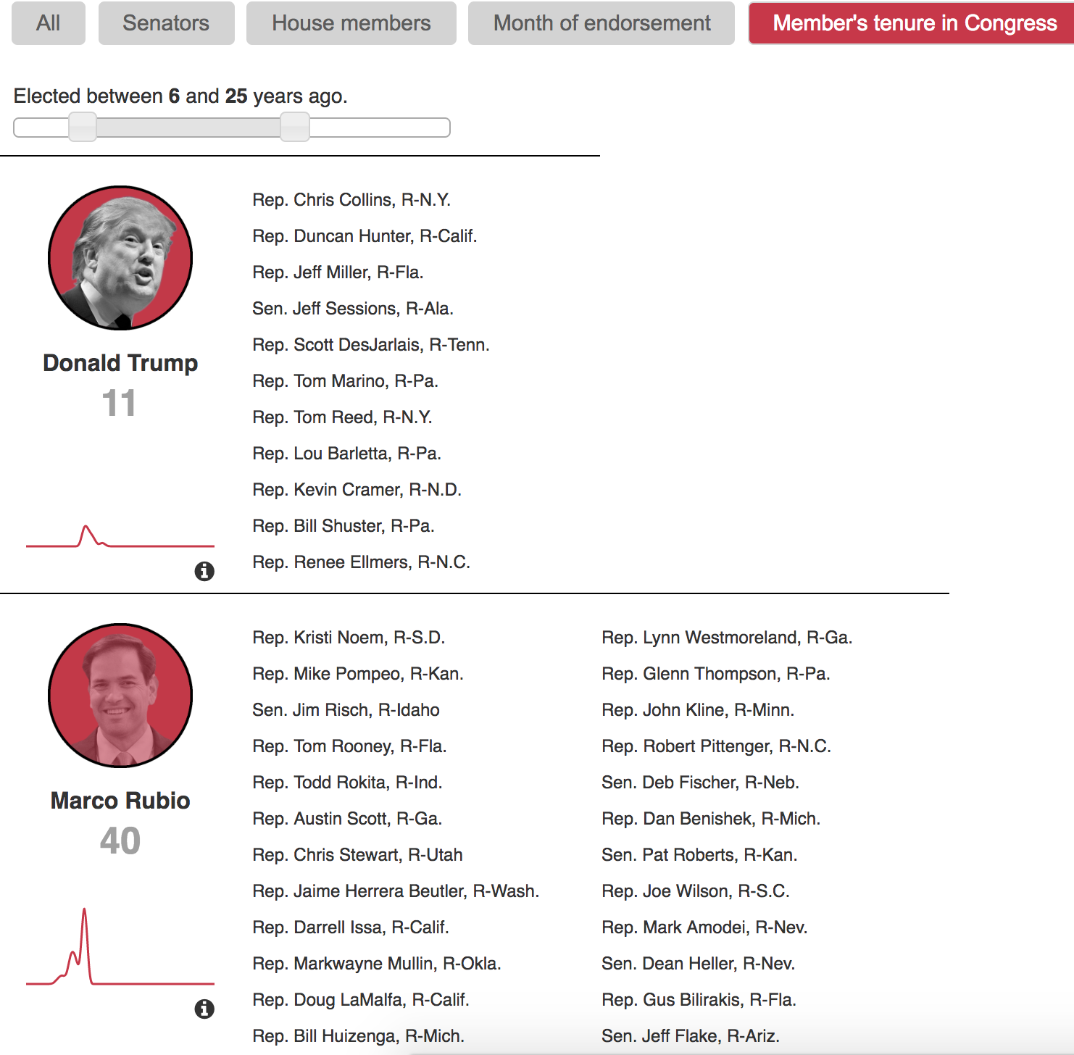
Making your own database

Slide 56
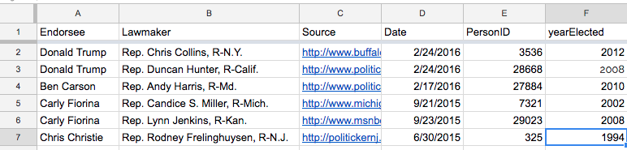
Making your own database

Slide 57
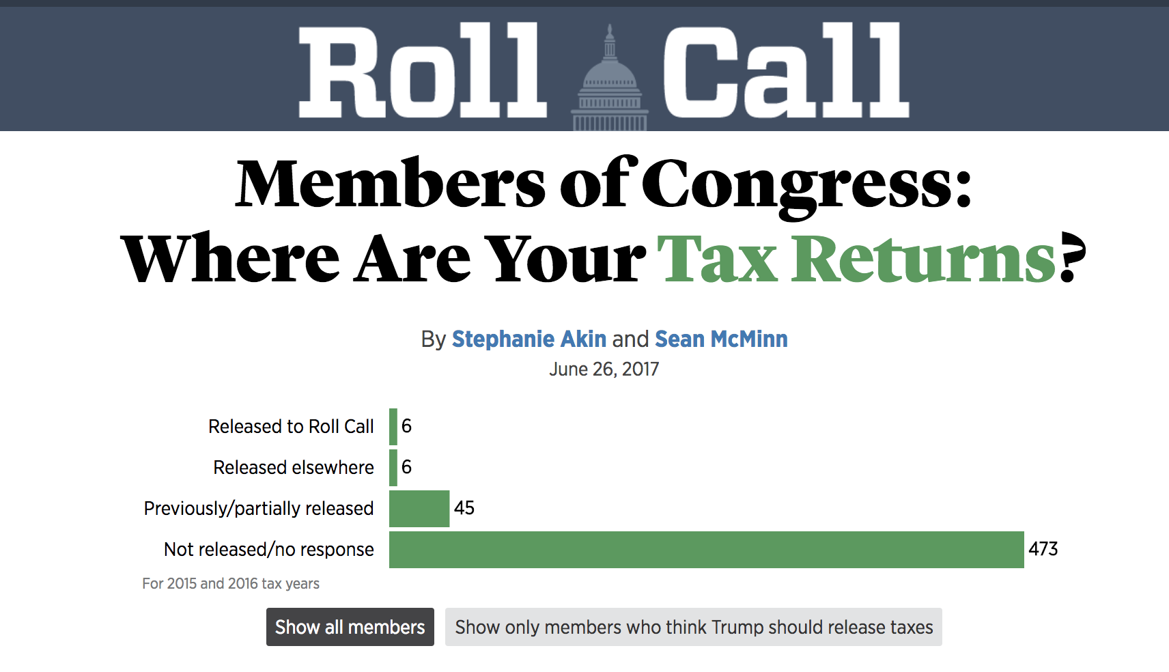
Making your own database

Slide 58
Making your own database
unique_key
member
state_ap_abbrv
party
Chamber
tax_return_status
trump_should_release
previous_trump_comment
prev_comment_source
leadership
document_link
document_src
Trump_notes
tax_notes
last_name
update_date

Slide 59
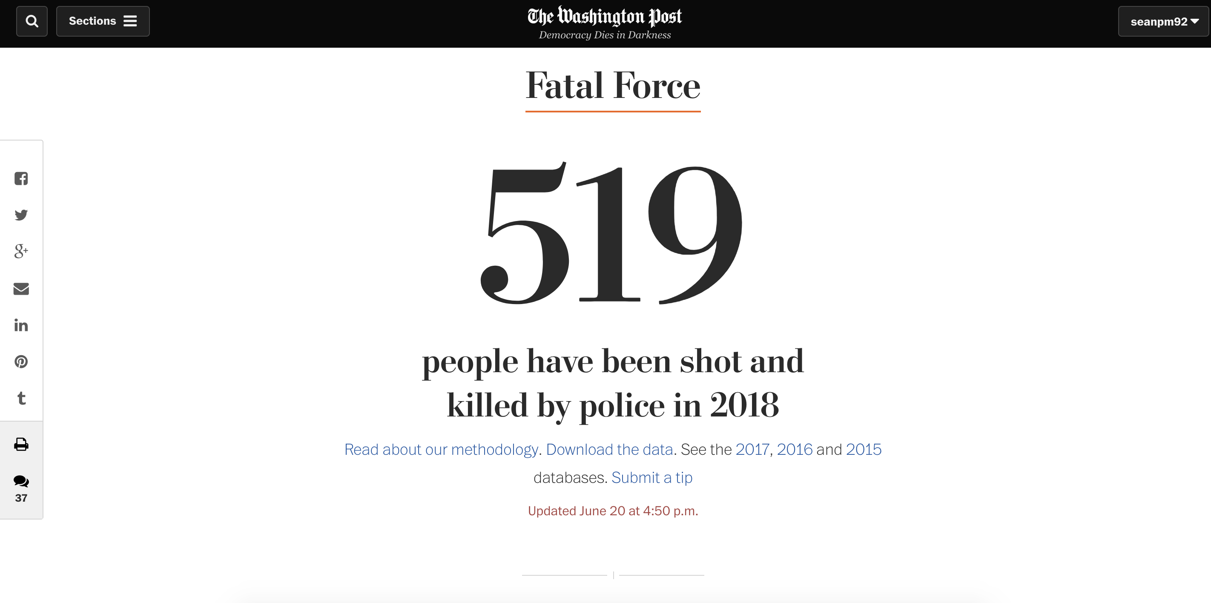
Making your own database

Slide 60
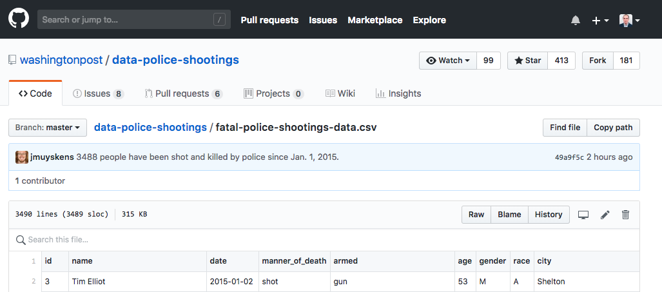
Making your own database

Slide 61
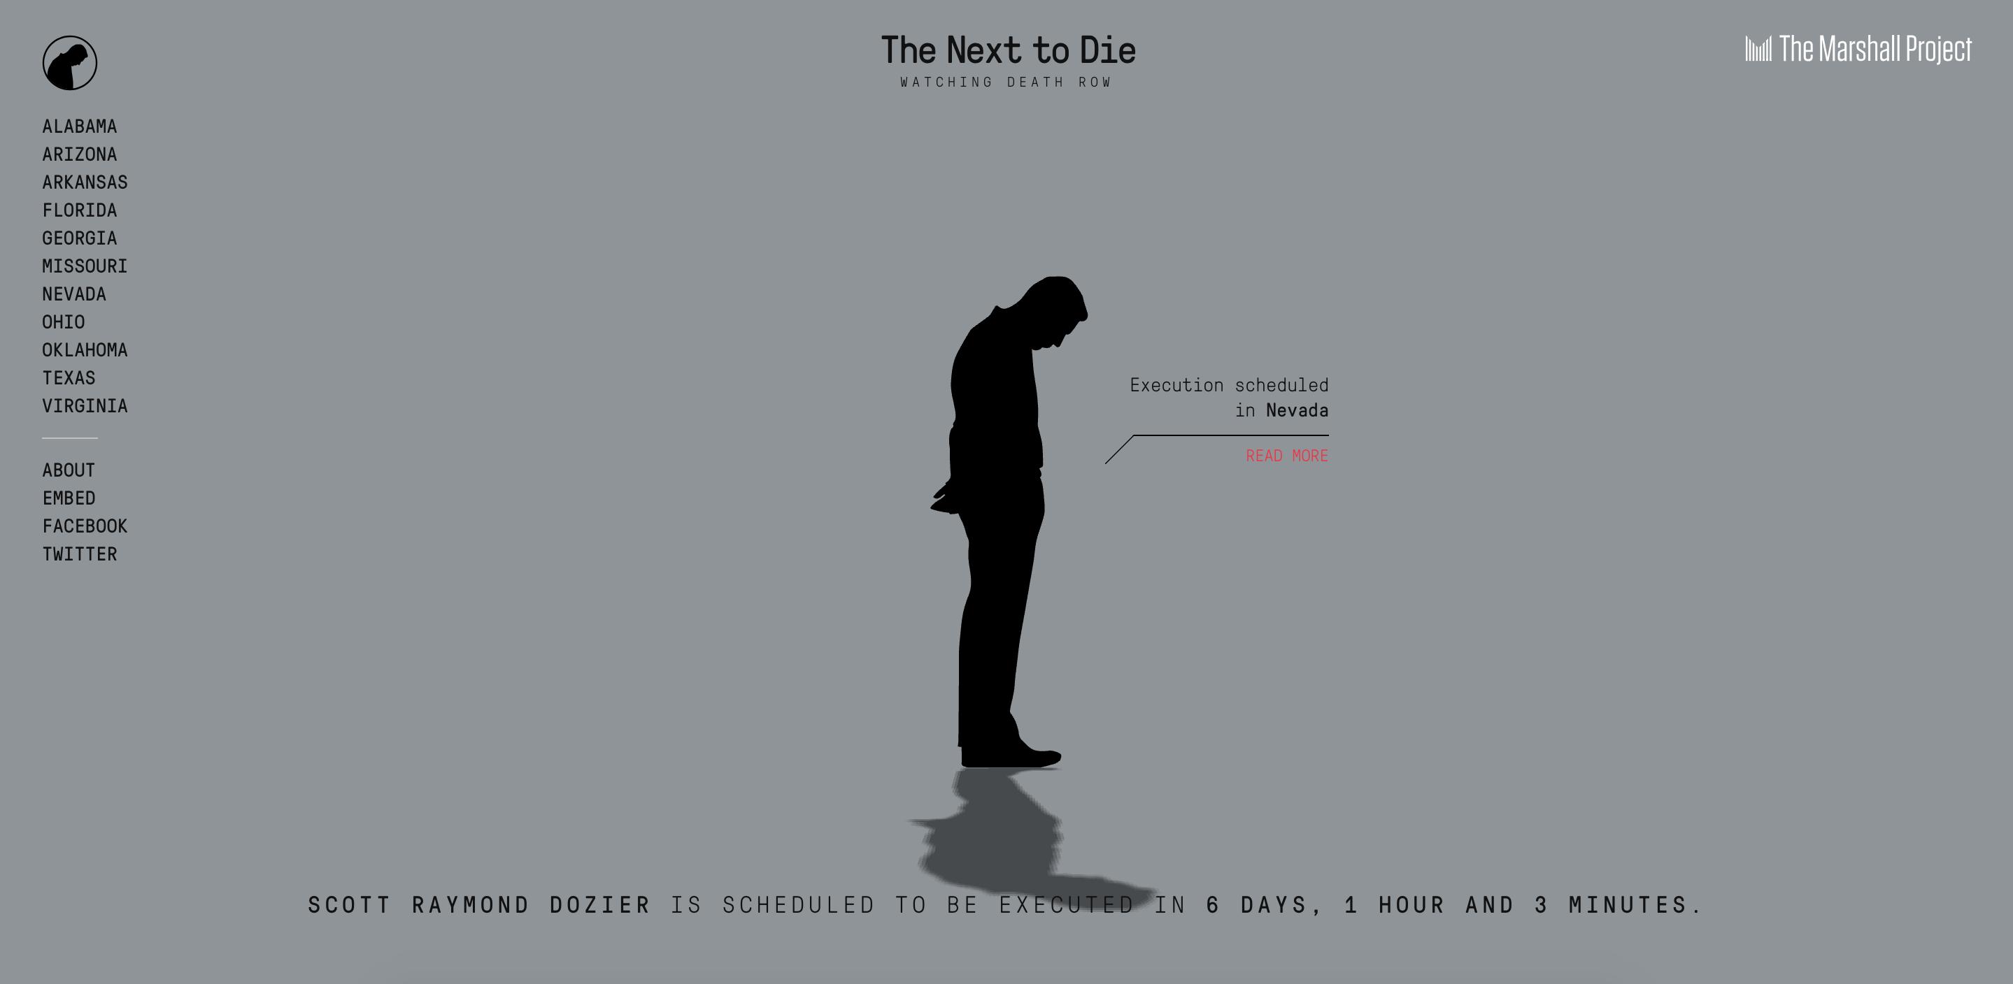
Making your own database

Slide 62
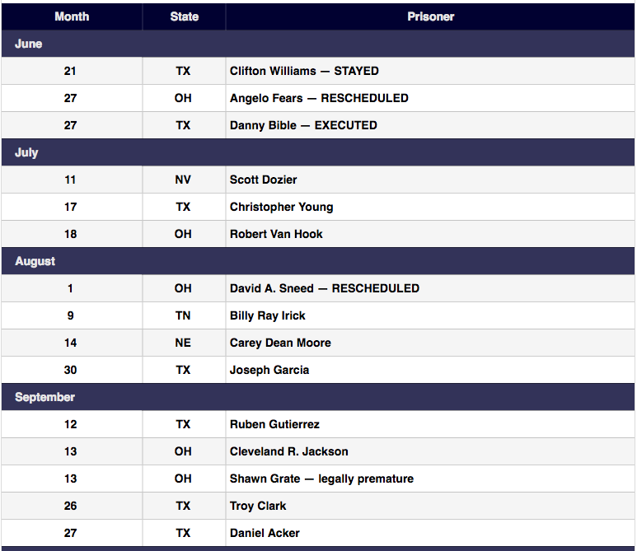
Making your own database

Slide 63
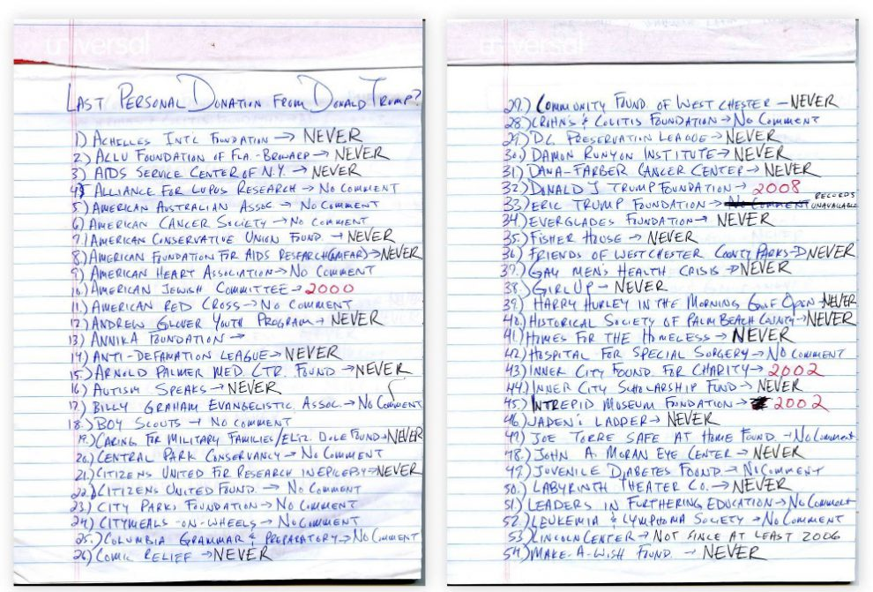
Making your own database

Slide 64

Making your own database
Treat each row as an “observation” or “individual”
Data should generally be “tall,” not “fat”
☺
☹

Slide 65


Making your own database
Be consistent … consistently!
☹
☹

Slide 66
Assignment
Think about an area you're interested in, or one you may do your final project on, and come up with a dataset you wish existed.
https://github.com/shmcminn/digitalframeworks-summer18/blob/master/class2/assignment2.md

